Slide 1
2.1: Describing Location in a Distribution

Slide 2
Section 2.1 Describing Location in a Distribution
After this section, you should be able to…
MEASURE position using percentiles
INTERPRET cumulative relative frequency graphs
TRANSFORM data
DEFINE and DESCRIBE density curves

Slide 3
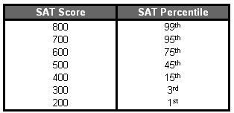
Measuring Position: Percentiles
One way to describe the location of a value in a distribution is to tell what percent of observations are less than it.
The p^{th} percentile of a distribution is the value with p percent of the observations less than it.

Slide 4
Jenny earned a score of 86 on her test. How did she perform relative to the rest of the class? What percentile is she ranked in?
6 7
7 2334
7 5777899
8 00123334
8 569
9 03

Slide 5
Jenny earned a score of 86 on her test. How did she perform relative to the rest of the class? What percentile is she ranked in?
6 7
7 2334
7 5777899
8 00123334
8 569
9 03
6 7
7 2334
7 5777899
8 00123334
8 569
9 03
Her score was greater than 21 of the 25 observations. Since 21 of the 25, or 84%, of the scores are below hers, Jenny is at the 84th percentile in the class’s test score distribution.

Slide 6
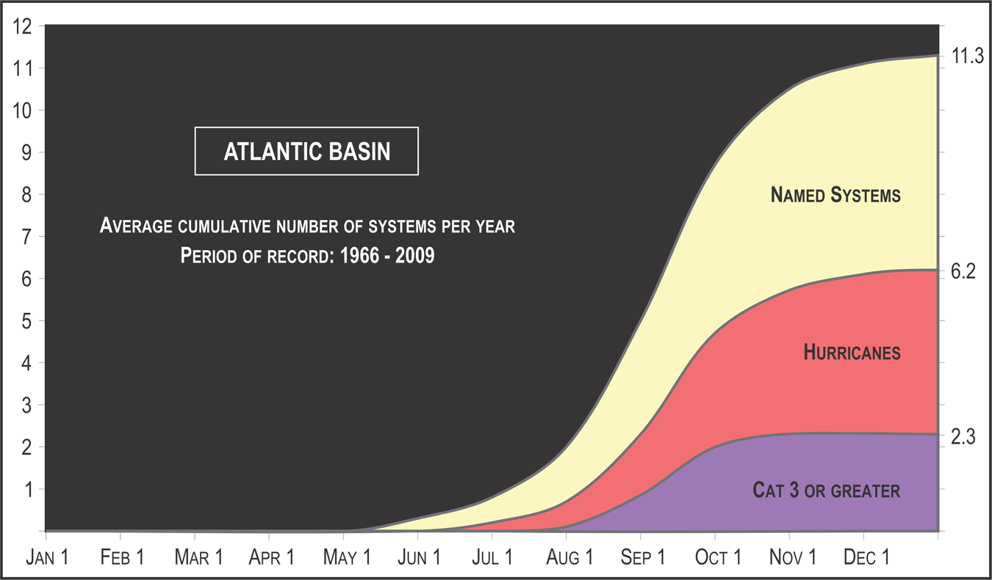

Slide 7
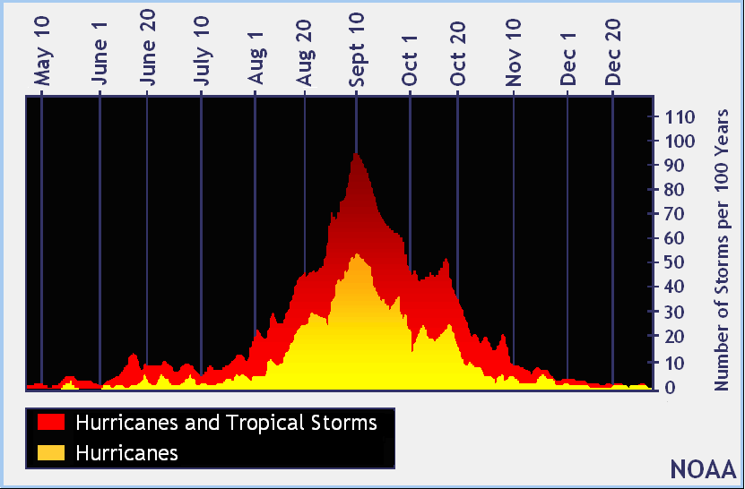

Slide 8
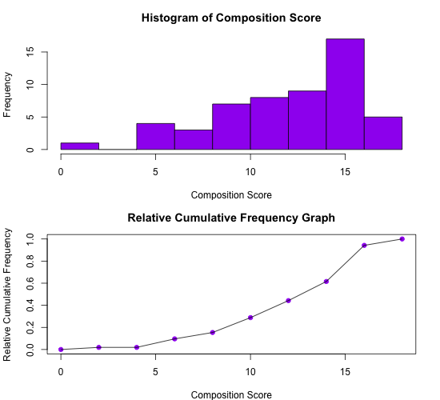
Cumulative Relative Frequency Graphs
A cumulative relative frequency graph displays the cumulative relative frequency of each class of a frequency distribution.

Slide 9
Transforming Data
Transforming converts the original observations from the original units of measurements to another scale.
Some transformations can affect the shape, center, and spread of a distribution.

Slide 10
Transforming Data: Add/Sub a Constant
Adding the same number a (either positive, zero, or negative) to each observation:
adds a to measures of center and location (mean, median, quartiles, percentiles), but
Does not change the shape of the distribution or measures of spread (range, IQR, standard deviation).

Slide 11
Transforming Data: Add/Sub a Constant
Let’s say Mrs. Daniel put a flat curve of 2 questions on the Chapter 1 MC scores…
What would happen to the….
Mean:
Median:
Standard Deviation:
Range:
Shape:

Slide 12
Transforming Data: Multiplying/Dividing
Multiplying (or dividing) each observation by the same number b (positive, negative, or zero):
multiplies (divides) measures of center and location by b
multiplies (divides) measures of spread by |b|
does not change the shape of the distribution

Slide 13
Transforming Data: Multiplying/Dividing
Let’s say Mrs. Daniel multiplied the number of questions each person got correct by 4 points …
What would happen to the Chapter 1 MC scores….
Mean:
Median:
Standard Deviation:
Range:
Shape:

Slide 14
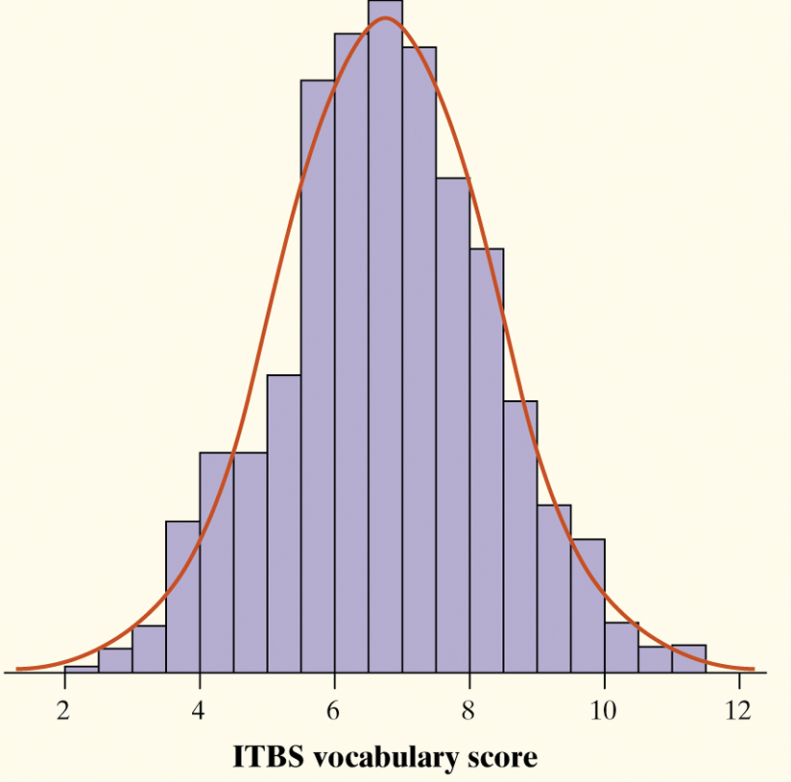
Density Curve
A density curve:
is always on or above the horizontal axis, and
has area exactly 1 underneath it.
A density curve describes the overall pattern of a distribution.
The area under the curve and above any interval of values on the horizontal axis is the proportion of all observations that fall in that interval.
The overall pattern of this histogram of the scores of all 947 seventh-grade students in Gary, Indiana, on the vocabulary part of the Iowa Test of Basic Skills (ITBS) can be described by a smooth curve drawn through the tops of the bars.

Slide 15
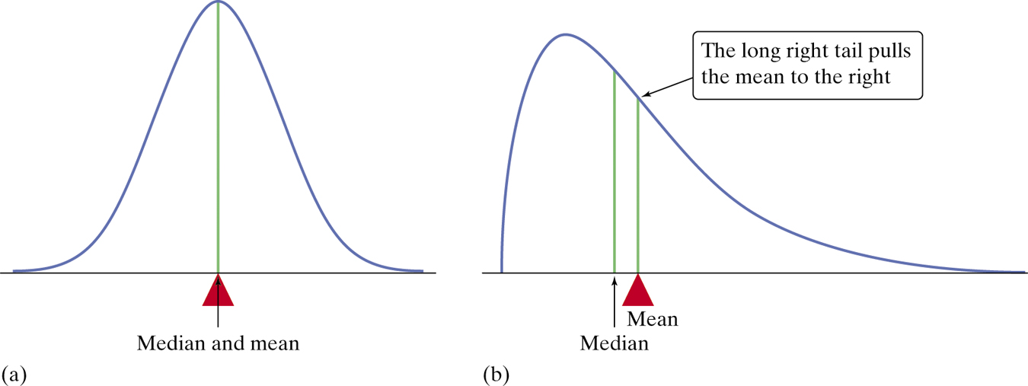
Describing Density Curves
The median and the mean are the same for a symmetric density curve. They both lie at the center of the curve. The mean of a skewed curve is pulled away from the median in the direction of the long tail.

Slide 16
Check Your Understanding
Knoebels Amusement Park in Elysburg, Pennsylvania does not charge for general admission or parking, but it does charge customers for each ride they take. How much do the rides cost at Knoebels?
1. Suppose you convert the cost of the rides from dollars to cents ($1=100 cents). Describe the shape, mean, and standard deviation of the distribution of ride cost in cents.
2. Knoebels’ managers decide to increase the cost of each ride by 25 cents. How would this the shape, center, and variability of this distribution compare with the distribution of cost in Question 1?

Slide 17
Check Your Understanding
1. Suppose you convert the cost of the rides from dollars to cents ($1=100 cents). Describe the shape, mean, and standard deviation of the distribution of ride cost in cents.
2. Knoebels’ managers decide to increase the cost of each ride by 25 cents. How would this the shape, center, and variability of this distribution compare with the distribution of cost in Question 1?

Slide 18
Check Your Understanding
1. Suppose you convert the cost of the rides from dollars to cents ($1=100 cents). Describe the shape, mean, and standard deviation of the distribution of ride cost in cents. The shape stays the same, the mean and standard deviation change units; for example from a mean of $1.705 to 170.5 cents.
2. Knoebels’ managers decide to increase the cost of each ride by 25 cents. How would this the shape, center, and variability of this distribution compare with the distribution of cost in Question 1? All values will increase by 25 cents, so the new mean will now be 195.5 cents. The entire graph will shift right to reflect the increase in cost of 25 cents, but the shape will stay the same.

Slide 19
Age of First 44 Presidents When They Were Inaugurated
Age | Frequency | Relative frequency | Cumulative frequency | Cumulative relative frequency
40-44 | 2 | 2/44 = 4.5% | 2 | 2/44 = 4.5%
45-49 | 7 | 7/44 = 15.9% | 9 | 9/44 = 20.5%
50-54 | 13 | 13/44 = 29.5% | 22 | 22/44 = 50.0%
55-59 | 12 | 12/44 = 27.3% | 34 | 34/44 = 77.3%
60-64 | 7 | 7/44 = 15.9% | 41 | 41/44 = 93.2%
65-69 | 3 | 3/44 = 6.8% | 44 | 44/44 = 100%
FYI: Extra Example
Age of Presidents When Inaugurated

Slide 20
Age of First 44 Presidents When They Were Inaugurated
Age | Frequency | Relative frequency | Cumulative frequency | Cumulative relative frequency
40-44 | 2 | 2/44 = 4.5% | 2 | 2/44 = 4.5%
45-49 | 7 | 7/44 = 15.9% | 9 | 9/44 = 20.5%
50-54 | 13 | 13/44 = 29.5% | 22 | 22/44 = 50.0%
55-59 | 12 | 12/44 = 27.3% | 34 | 34/44 = 77.3%
60-64 | 7 | 7/44 = 15.9% | 41 | 41/44 = 93.2%
65-69 | 3 | 3/44 = 6.8% | 44 | 44/44 = 100%
Age of Presidents When Inaugurated

Slide 21
1. Was Barack Obama, who was inaugurated at age 47, unusually young?
2. Estimate and interpret the 65th percentile of the distribution
65
11
47
58

