Slide 1
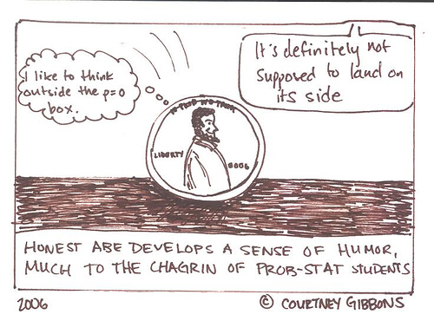
5.2: Probability Rules

Slide 2
Section 5.2 Probability Rules
After this section, you should be able to…
DESCRIBE chance behavior with a probability model
DEFINE and APPLY basic rules of probability
DETERMINE probabilities from two-way tables
CONSTRUCT Venn diagrams and DETERMINE probabilities

Slide 3
Basic Rules of Probability
The probability of any event is a number between 0 and 1.
All possible outcomes sum to 1.
If all outcomes in a sample space ( ex: rolling a single dice) are equally likely, the probability the event “A” occurs can be found using the formula:
P(A) = $\frac{number of outcomes}{total number of outcomes}$
The probability that an event does not occur is 1 minus the probability the event does occur.

Slide 4
Probability Models
The sample space S of a chance process is the set of all possible outcomes.
A probability model is a description of some chance process that consists of two parts: a sample space S and a probability for each outcome.
Example of Coin Toss:
Sample Space: Either heads or tails.
Probability: Heads (0.5) and Tails (0.5)

Slide 5
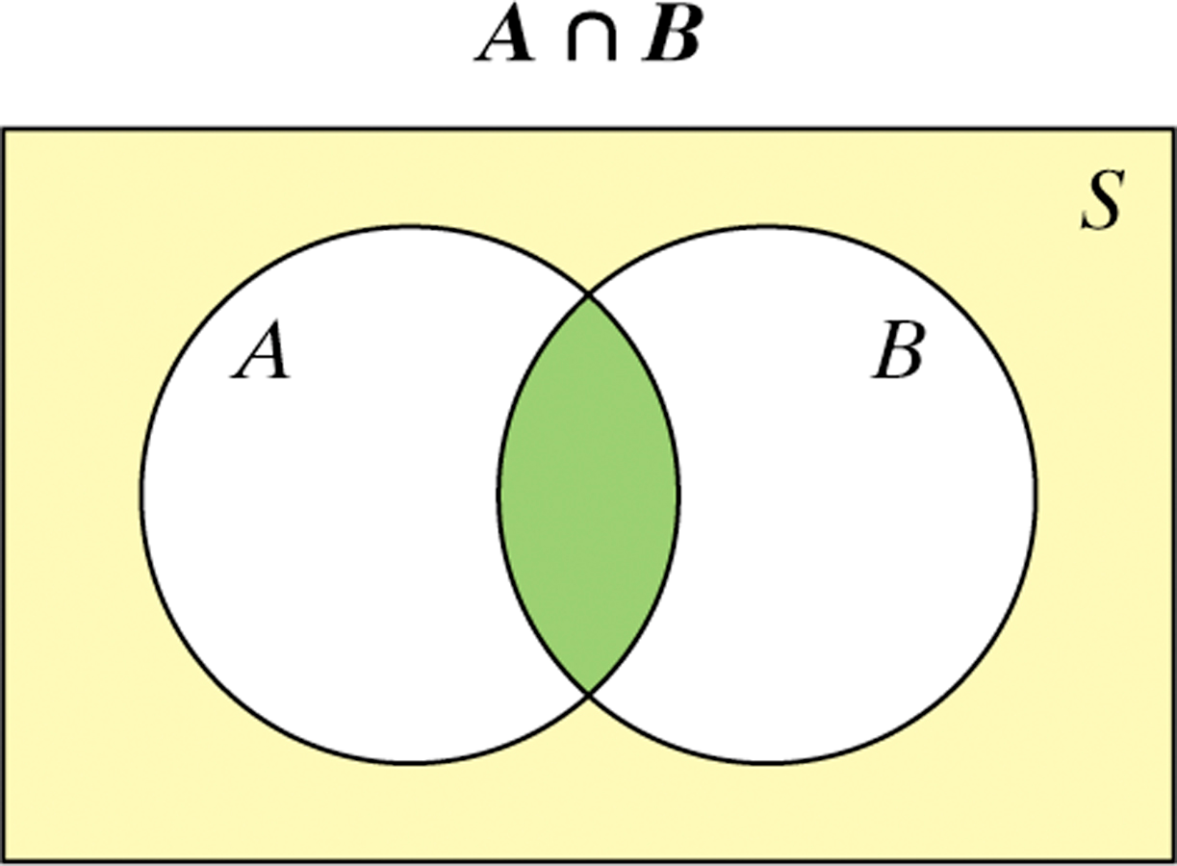
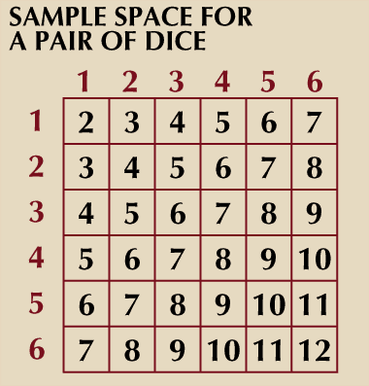
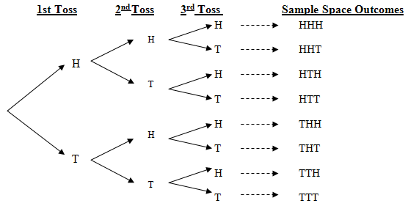
Probability Models
Venn Diagram, Tree Diagram, List, Chart, etc.

Slide 6
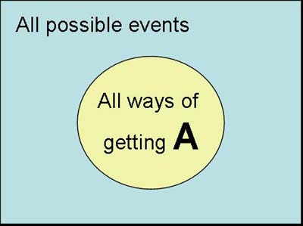
Probability Models
Probability models allow us to find the probability of any collection of outcomes.
An event is any collection of outcomes from some chance process. That is, an event is a subset of the sample space. Events are usually designated by capital letters, like A, B, C, and so on.
Specific “event” examples:
Flipping 3 heads in a row
Rolling two dice that sum to 5

Slide 7
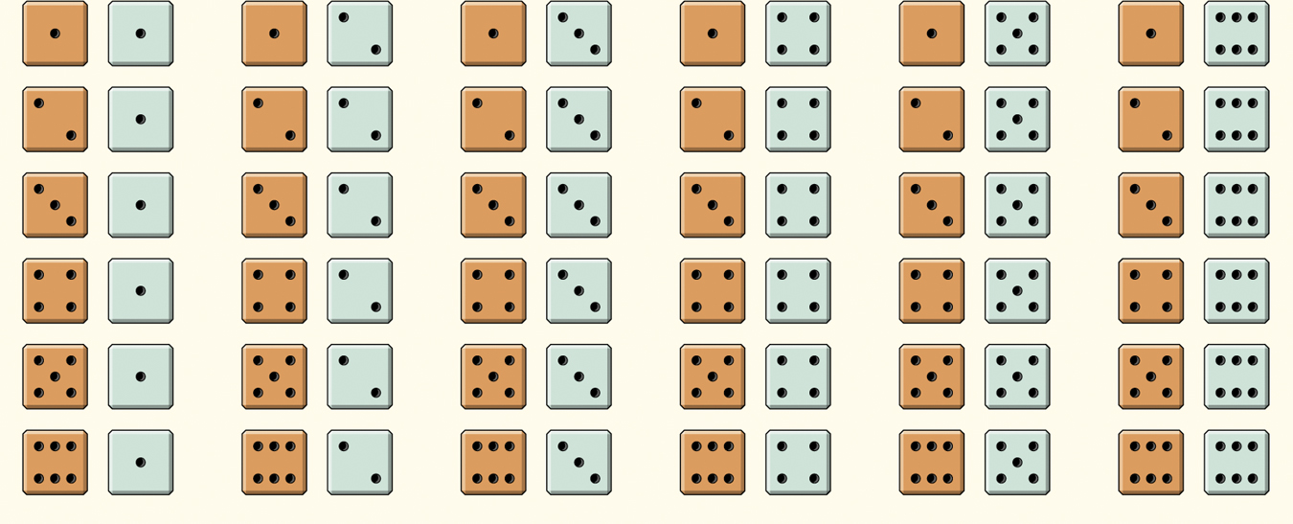
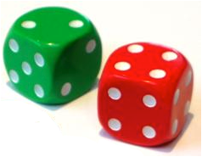
Sample Space: Rolling Two Dice
The probability model for the chance process of rolling two fair, six-sided dice – one that’s red and one that’s green.
Sample Space
36 Outcomes
Since the dice are fair, each outcome is equally likely.
Each outcome has probability 1/36.

Slide 8
Probability Models
Event:
Rolling a sum of “5” with 2 dice or P(A)= sum of 5
Event Space:
There are 4 different combination of dice rolls that sum to 5.
Solution:
Since each outcome has probability 1/36:
P(A) = 4/36 or 1/9.

Slide 9
What type of Pizza do you like?
Meat
Veggies
Veggies and meat
Neither (cheese)
***There are NO other choices at this pizzeria***

Slide 10
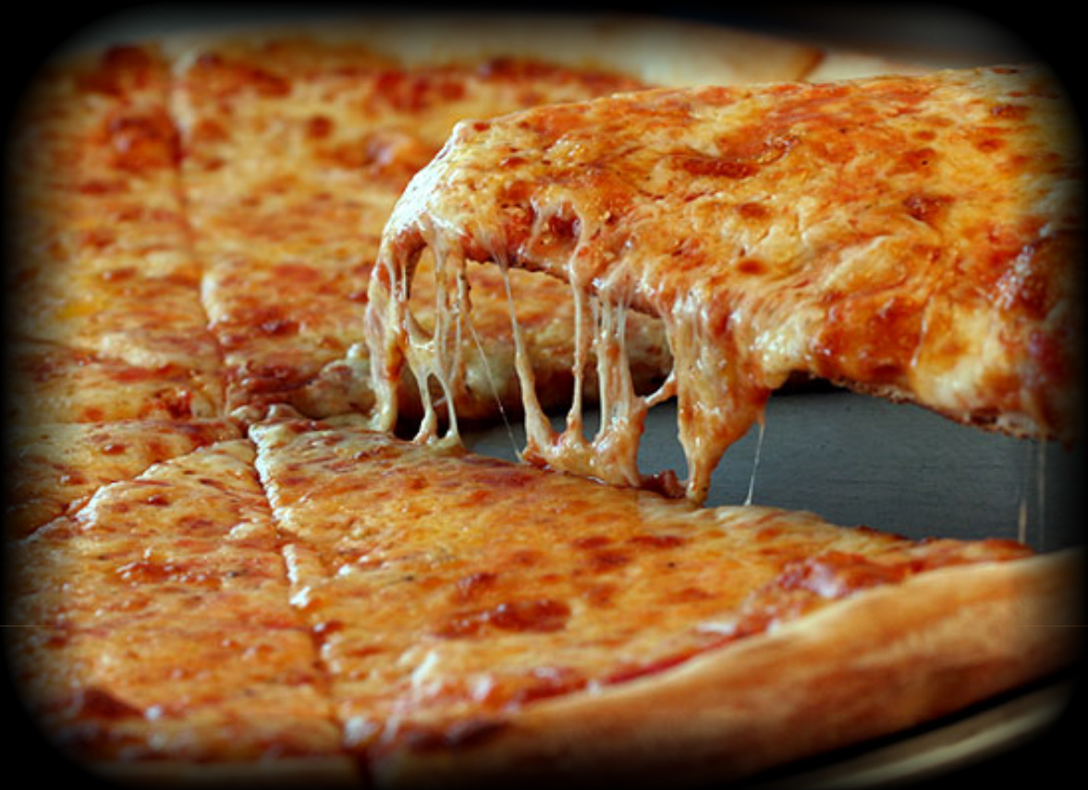
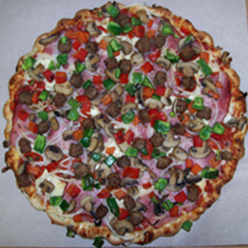
Meat
Veggies
Meat & Veggies
Neither (Cheese)

Slide 11
What is the probability that a randomly selected student…
Likes meat
Likes veggies
Likes veggies and meat
Likes neither (cheese)
Like either veggies or meat

Slide 12
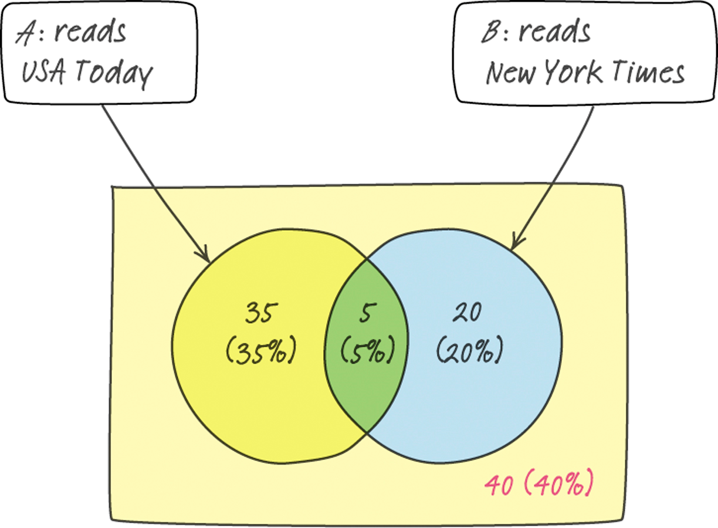

Slide 13
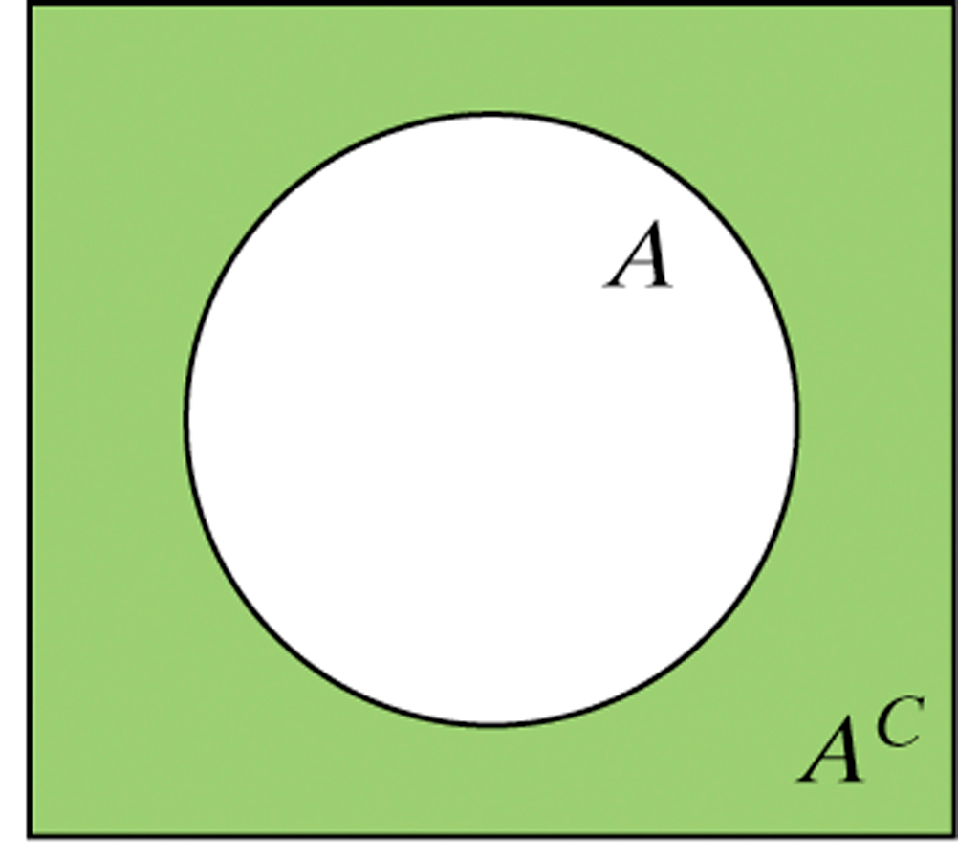
Complement
The event that did not occur….not A
A= airplane takes off on time
A^{c}= airplane does not take off on time

Slide 14
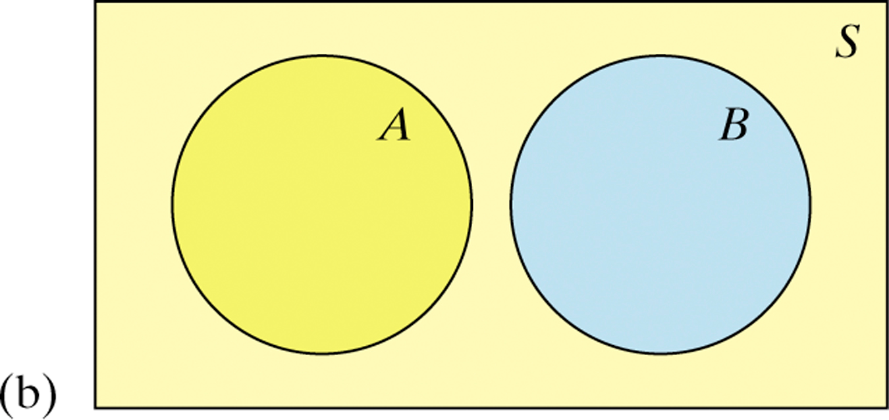
Mutually Exclusive
Two events that cannot occur at the same time. There are no common outcomes.
Student is EITHER a Junior or Senior

Slide 15
Intersection
Probability of both events occurring.
For example: A = likes salad, B = likes meat, therefore P(A and B) = likes both salad and meat

Slide 16
Calculating Probabilities
Complement of A
Complement = 1 – P(A)
Mutually Inclusive (A or B)
P(A or B) = P(A) + P(B) – P(A and B)
Intersection (A and B)
P(A and B)

Slide 17
2014 AP Statistics Exam Scores Probabilities:
Is this a legitimate probability model? Justify.
(b) Find the probability that the chosen student scored 3 or better.
Score | 1 | 2 | 3 | 4 | 5
Probability | 0.223 | 0.183 | 0.235 | 0.224 | 0.125

Slide 18
2014 AP Statistics Exam Scores Probabilities:
Is this a legitimate probability model? Justify.
Each probability is between 0 and 1 and the sum of the probabilities : 0.223 + 0.193 + 0.235 + 0.224 + 0.125 = 1.
(b) Find the probability that the chosen student scored 3 or better.
The probability of scoring a 3 or better: 0.235 + 0.224 + 0.125 = 0.584
Score | 1 | 2 | 3 | 4 | 5
Probability | 0.223 | 0.183 | 0.235 | 0.224 | 0.125
0.193

Slide 19
Online-learning courses are rapidly gaining popularity among college students. Randomly select an undergraduate student who is taking online-learning courses for credit and record the student’s age. Here is the probability model:
Age group (yr): | 18 to 23 | 24 to 29 | 30 to 39 | 40 or over
Probability: | 0.57 | 0.17 | 0.14 | 0.12
Is this a legitimate probability model? Justify.
Find the probability that the chosen student is not in the traditional college age group (18 to 23 years).

Slide 20
Distance-learning courses are rapidly gaining popularity among college students. Randomly select an undergraduate student who is taking distance-learning courses for credit and record the student’s age. Here is the probability model:
Age group (yr): | 18 to 23 | 24 to 29 | 30 to 39 | 40 or over
Probability: | 0.57 | 0.17 | 0.14 | 0.12
Is this a legitimate probability model? Justify.
Find the probability that the chosen student is not in the traditional college age group (18 to 23 years).
Each probability is between 0 and 1 and
0.57 + 0.17 + 0.14 + 0.12 = 1
P(not 18 to 23 years) = 1 – P(18 to 23 years)
= 1 – 0.57 = 0.43

Slide 21
What is the relationship between educational achievement and home ownership? A random sample of 500 people and each member of the sample was identified as a high school graduate (or not) and as a home owner (or not). The two-way table displays the data.
 | High School Graduate | Not a High School Graduate | Total
Homeowner | 221 | 119 | 340
Not a Homeowner | 89 | 71 | 160
Total | 310 | 190 | 500
What is the probability that a randomly selected person…
(a) is a high school graduate
(b) is a high school graduate and owns a home
(c) is a high school graduate or owns a home

Slide 22
What is the relationship between educational achievement and home ownership? A random sample of 500 people and each member of the sample was identified as a high school graduate (or not) and as a home owner (or not). The two-way table displays the data.
 | High School Graduate | Not a High School Graduate | Total
Homeowner | 221 | 119 | 340
Not a Homeowner | 89 | 71 | 160
Total | 310 | 190 | 500
What is the probability that a randomly selected person…
(a) is a high school graduate = 310/500
(b) is a high school graduate and owns a home = 221/500
(c) is a high school graduate or owns a home = 310 + 119 = 429/500

