Slide 1
6.3: Binomial and Geometric Random Variables

Slide 2
After this section, you should be able to…
DETERMINE whether the conditions for a binomial setting are met
COMPUTE and INTERPRET probabilities involving binomial random variables
CALCULATE the mean and standard deviation of a binomial random variable and INTERPRET these values in context
CALCULATE probabilities involving geometric random variables

Slide 3
Pop Quiz!!! (2 minutes) Multiple Choice (A,B,C,D,E) - Take out a blank sheet of paper & number from 1 to 10. - No Cheating!!!

Slide 4
Time to Grade the Quizzes
Exchange papers with a classmate
Mark only the wrong answers.
Do not place a check next to correct answers

Slide 5
Answers
C
E
C
B
C
D
D
D
E
B
NOW: Lets make a dot plot of the # of correct answers from each students

Slide 6
In the “Pop Quiz” activity, each student is performing repeated trials of the same chance process: guessing the answer to a multiple choice question. We’re interested in the number of times that a specif event occurs: getting a correct answer (which we’ll call a “success”). Knowing the outcome of one question (right or wrong guess) tells us nothing about the outcome of any other question. That is, the trials are independent. The number of trials is fixed in advance: n = 10. A student’s probability of getting a “success” is the same on each trial: p = 0.2. When these conditions are met, we have a BINOMIAL SETTING.

Slide 7
Binomial and Geometric Random Variables
Binomial Settings
When the same chance process is repeated several times, we are often interested in whether a particular outcome does or doesn’t happen on each repetition. In some cases, the number of repeated trials is fixed in advance and we are interested in the number of times a particular event (called a “success”) occurs. If the trials in these cases are independent and each success has an equal chance of occurring, we have a binomial setting.
Definition:
A binomial setting arises when we perform several independent trials of the same chance process and record the number of times that a particular outcome occurs. The four conditions for a binomial setting are
B
• Binary? The possible outcomes of each trial can be classified as “success” or “failure.”
I
• Independent? Trials must be independent; that is, knowing the result of one trial must not have any effect on the result of any other trial.
N
• Number? The number of trials n of the chance process must be fixed in advance.
S
• Success? On each trial, the probability p of success must be the same.

Slide 8
An important skill for using a binomial distribution is the ability to recognize a binomial situation.
An engineer chooses an SRS of 10 switches from a shipment of 10000 switches. Suppose that (unknown to the engineer) 10% of the switches in the shipment are bad. The engineer counts the number X of bad switches in the sample.
Is this a binomial setting?

Slide 9
Flip a coin and let X=number of flips to get a head Is this a binomial setting?

Slide 10
Binomial and Geometric Random Variables
Binomial Random Variable
Consider tossing a coin n times. Each toss gives either heads or tails. Knowing the outcome of one toss does not change the probability of an outcome on any other toss. If we define heads as a success, then p is the probability of a head and is 0.5 on any toss.
The number of heads in n tosses is a binomial random variable X. The probability distribution of X is called a binomial distribution.
Definition:
The count X of successes in a binomial setting is a binomial random variable. The probability distribution of X is a binomial distribution with parameters n and p, where n is the number of trials of the chance process and p is the probability of a success on any one trial. The possible values of X are the whole numbers from 0 to n.
Note: When checking the Binomial condition, be sure to check the BINS and make sure you’re being asked to count the number of successes in a certain number of trials!

Slide 11
An important skill for using a binomial distribution is the ability to recognize a binomial situation.
IQ scores are normally distributed with a mean 100 and standard deviation 12. A SRS of 25 scores are drawn. Let X = number of scores that are above 110.

Slide 12
Which of the following lead to a binomial distribution?
I An inspection procedure at an automobile manufacturing plant involves selecting a sample of cars from the assembly line and noting for each car whether there are no defects, at least one major defect or only minor defect.
II As students study more and more during their AP Statistics class, their chances of getting an A on any given test continue to improve. The teacher is interested in the probability of any given student receiving various numbers A’s on the class exams

Slide 13
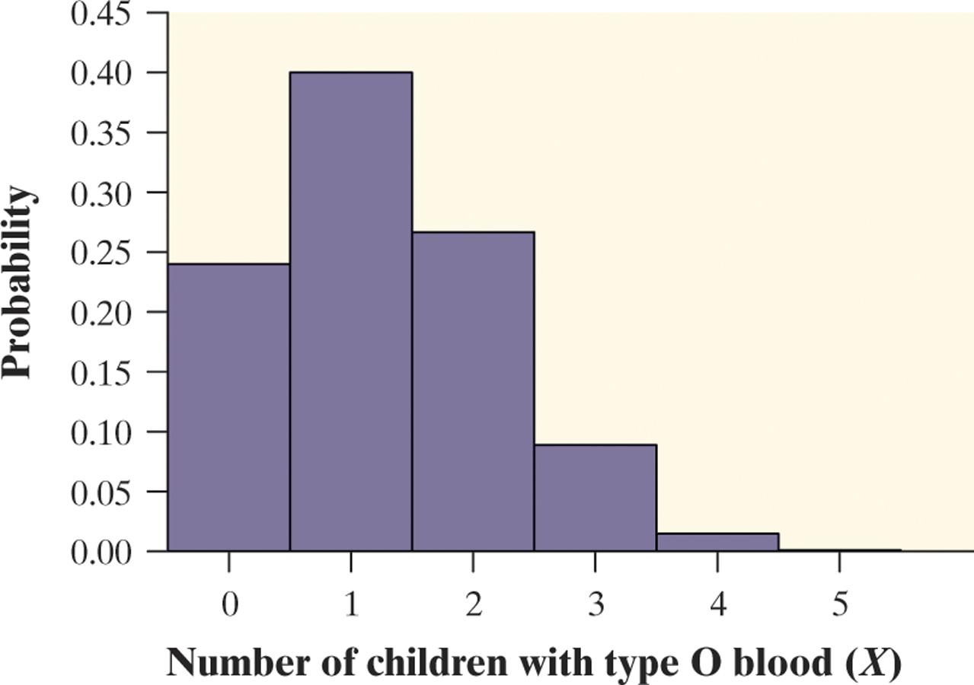
Binomial Distribution: Describe
We describe the probability distribution of a binomial random variable just like any other distribution – shape, center, and spread.
Consider the probability distribution of X = number of children with type O blood in a family with 5 children.
x_{i} | 0 | 1 | 2 | 3 | 4 | 5
p_{i} | 0.2373 | 0.3955 | 0.2637 | 0.0879 | 0.0147 | 0.00098

Slide 14
Binomial Distribution: Describe
x_{i} | 0 | 1 | 2 | 3 | 4 | 5
p_{i} | 0.2373 | 0.3955 | 0.2637 | 0.0879 | 0.0147 | 0.00098
Shape: The probability distribution of X is skewed to the right. It is more likely to have 0, 1, or 2 children with type O blood than a larger value.
Center: The median number of children with type O blood is 1. The mean is 1.25.
Spread: The variance of X is 0.9375 and the standard deviation is 0.96.

Slide 15
Binomial Distribution: Mean and Standard Deviation
If a count X has the binomial distribution with number of trials n and probability of success p, the mean and standard deviation of X are
Note: These formulas work ONLY for binomial distributions.
They can’t be used for other distributions!

Slide 16
Find the mean and standard deviation of X.
X is a binomial random variable with parameters n = 21 and p = 1/3.

Slide 17
Find the mean and standard deviation of X.
X is a binomial random variable with parameters n = 21 and p = 1/3.

Slide 18
Calculator: Binomial Probability
2nd, VARS (DISTR),
binompdf
binomcdf
Binompdf calculates equal to value
For “PERCISE” numbers
Same idea as normpdf and normcdf

Slide 19
Binomial Probabilities
Each child of a particular pair of parents has probability 0.25 of having type O blood. Genetics says that children receive genes from each of their parents independently. If these parents have 5 children, the count X of children with type O blood is a binomial random variable with n = 5 trials and probability p = 0.25 of a success on each trial. In this setting, a child with type O blood is a “success” (S) and a child with another blood type is a “failure” (F).
What’s P(X = 2)?

Slide 20
Binomial Probabilities
CHECK CONDITIONS:
Binary: Yes. Type O blood = yes and not type O blood = no. There are only two options.
Independent: Stated.
Number: Yes. The number of trials is stated as 5.
Success: Yes. The probability of success is the same on each attempt, p = 0.25.

Slide 21
Binomial Probabilities
Using your calculator:
Binompdf, enter the following information:
Trials: 5
P: .25
X value: 2
Answer: 0.263671875
We are using binompdf in this example because we want the “precise” probability of 2.
CONCLUDE:
There is a 26.37% chance that the family will have two children with type O blood.

Slide 22
Binomial Probabilities (By Hand Solution)
Each child of a particular pair of parents has probability 0.25 of having type O blood. Genetics says that children receive genes from each of their parents independently. If these parents have 5 children, the count X of children with type O blood is a binomial random variable with n = 5 trials and probability p = 0.25 of a success on each trial. In this setting, a child with type O blood is a “success” (S) and a child with another blood type is a “failure” (F).
What’s P(X = 2)?
P(SSFFF) = (0.25)(0.25)(0.75)(0.75)(0.75) = (0.25)²(0.75)³ = 0.02637
However, there are a number of different arrangements in which 2 out of the 5 children have type O blood:
SSFFF
SFSFF
SFFSF
SFFFS
FSSFF
FSFSF
FSFFS
FFSSF
FFSFS
FFFSS
Verify that in each arrangement, P(X = 2) = (0.25)²(0.75)³ = 0.02637
Therefore, P(X = 2) = 10(0.25)²(0.75)³ = 0.2637

Slide 23
Inheriting Blood Type
Each child of a particular pair of parents has probability 0.25 of having blood type O. Suppose the parents have 5 children.
Find the probability that exactly 3 of the children have type O blood.
Should the parents be surprised if more than 3 of their children have type O blood?
We have already checked the conditions, so just do the calculations.

Slide 24
Inheriting Blood Type
Each child of a particular pair of parents has probability 0.25 of having blood type O. Suppose the parents have 5 children
(a) Find the probability that exactly 3 of the children have type O blood.
Binompdf :(5, .25, 3) = 0.08789
There is an 8.79% percent chance that the family will have three children with type O blood.
(b) Should the parents be surprised if more than 3 of their children have type O blood?
Binomcdf: (5, .25, 4, 5) = 0.015625
There is a 1.5% percent chance that more than 3 of the children (aka at least 4 children) will have type O blood. This is surprising!

Slide 25
Inheriting Blood Type (By Hand Solution)
Each child of a particular pair of parents has probability 0.25 of having blood type O. Suppose the parents have 5 children
(a) Find the probability that exactly 3 of the children have type O blood.
Let X = the number of children with type O blood. We know X has a binomial distribution with n = 5 and p = 0.25.
(b) Should the parents be surprised if more than 3 of their children have type O blood?
To answer this, we need to find P(X > 3).
Since there is only a 1.5% chance that more than 3 children out of 5 would have Type O blood, the parents should be surprised!

Slide 26
Binomial Distributions: Statistical Sampling
The binomial distributions are important in statistics when we want to make inferences about the proportion p of successes in a population.
Sampling Without Replacement Condition
When taking an SRS of size n from a population of size N, we can use a binomial distribution to model the count of successes in the sample as long as

Slide 27
Example: CDs
Suppose 10% of CDs have defective copy-protection schemes that can harm computers. A music distributor inspects an SRS of 10 CDs from a shipment of 10,000. Let X = number of defective CDs. What is P (X = 0)?

Slide 28
Example: CDs
CHECK CONDITIONS:
Binary: Yes. Defective or not defective, only two options.
Independent: We can safely assume independence in this case because we are sampling less than 10% of the population.
Number: Yes. The number of trials is stated as 10.
Success: Yes. The probability of success is the same on each attempt, p = 0.10.
DO & CONCLUDE:
Binompdf (10, .1, 0) = 0.3486784401
There is a 34.87% that there will be no defective CDs in the sample.

Slide 29
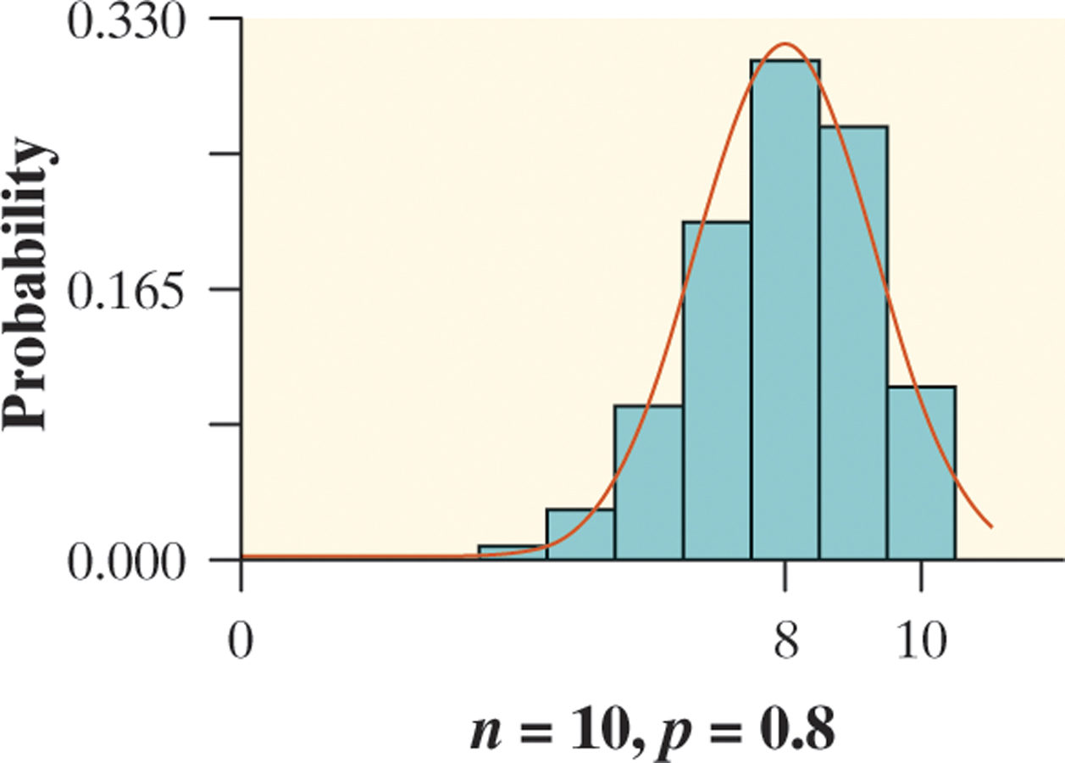
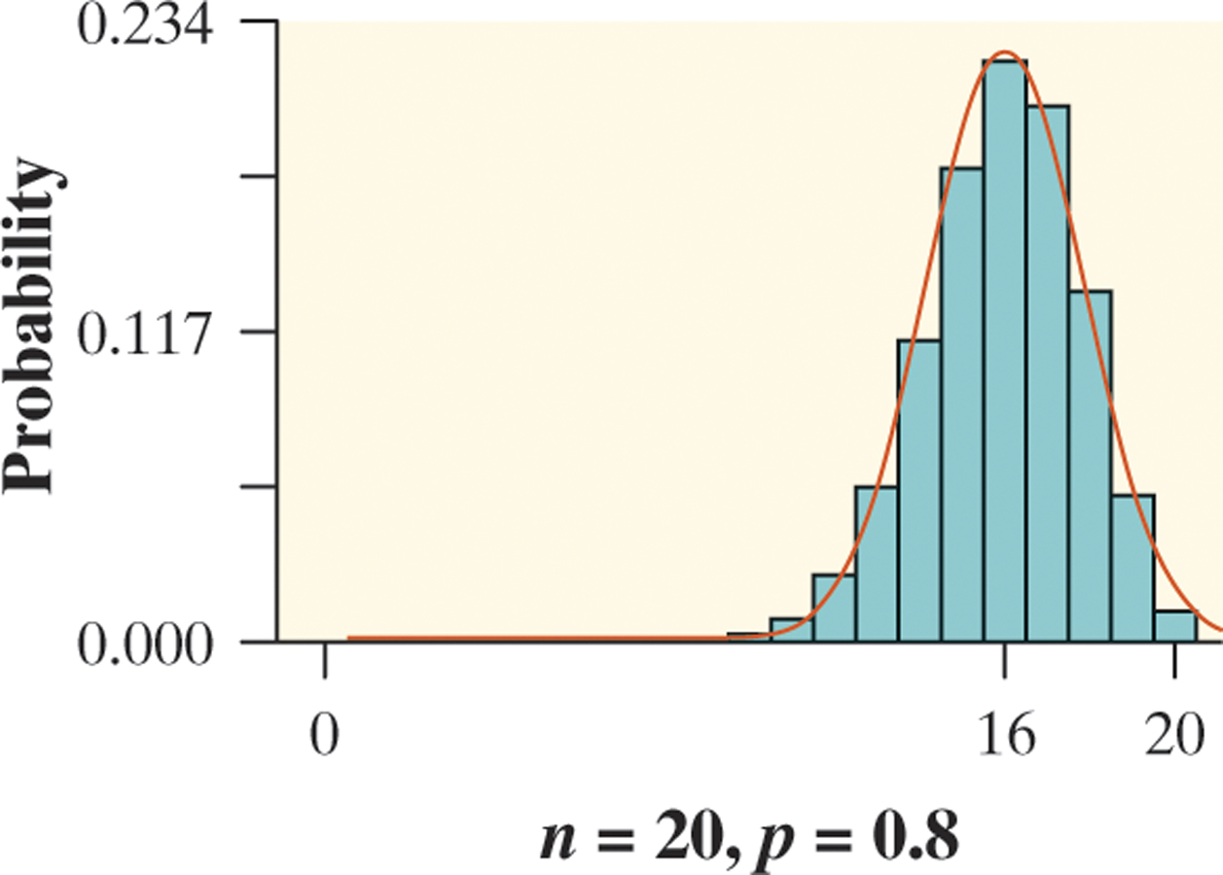
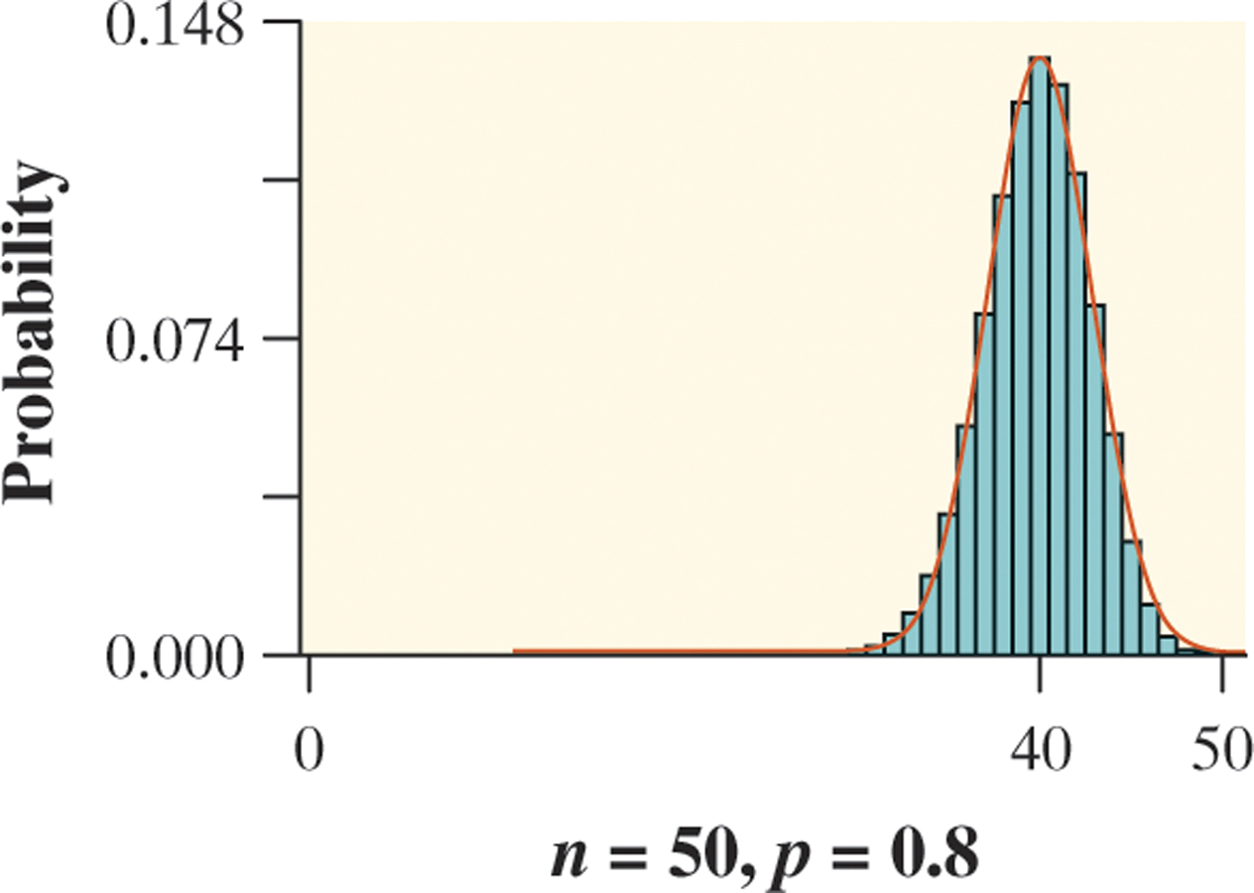
Binomial Distributions: Normal Approximation
As n gets larger, something interesting happens to the shape of a binomial distribution.

Slide 30
Binomial Distributions: Normal Approximation
Suppose that X has the binomial distribution with n trials and success probability p. When n is large, the distribution of X is approximately Normal with mean and standard deviation
As a rule of thumb, we will use the Normal approximation when n is so large that np ≥ 10 and n(1 – p) ≥ 10. That is, the expected number of successes and failures are both at least 10. We use the normal approximation more in Units 8-10.

Slide 31
Example: Attitudes Toward Shopping
Sample surveys show that fewer people enjoy shopping than in the past. A survey asked a nationwide random sample of 2500 adults if they agreed or disagreed that “I like buying new clothes, but shopping is often frustrating and time-consuming.” Suppose that exactly 60% of all adult US residents would say “Agree” if asked the same question. Let X = the number in the sample who agree. Estimate the probability that 1520 or more of the sample agree.
Consider the normal approximation for this setting.

Slide 32
Binomial:
Binary: There are only 2 options. Success = agree, Failure = don’t agree
Independent: Because the population of U.S. adults is greater than 25,000, it is reasonable to assume the sampling without replacement condition is met; we are sampling less than 10% of the population.
Number of Trials: n = 2500 trials of the chance process
Success: The probability of selecting an adult who agrees is p = 0.60
Binomcdf(2500, 0.6, 1520, 2500) = 0.213139

Slide 33
OR:
Normal: Since np = 2500(0.60) = 1500 and n(1 – p) = 2500(0.40) = 1000 are both at least 10, we may use the Normal approximation.
Calculate the mean.
Calculate standard deviation.
Use Calculator
Normalcdf (1520, 2500, 1500, 24.49) = 0.207061
CONCLUDE:
There is a 20.61% that 1520 or more of the people in the sample agree.

Slide 34
Geometric Settings
A geometric setting arises when we perform independent trials of the same chance process and record the number of trials until a particular outcome occurs. The four conditions for a geometric setting are
Binary? The possible outcomes of each trial can be classified as “success” or “failure.”
B
Independent? Trials must be independent; that is, knowing the result of one trial must not have any effect on the result of any other trial.
I
Trials? The goal is to count the number of trials until the first success occurs.
T
S
Success? On each trial, the probability p of success must be the same.

Slide 35
Geometric Random Variable
Geometric random variable: the number of trials needed to get the first success.
Examples:
How many M&Ms are drawn until a blue one is selected?
How many students will I draw from a hat until a pick a senior?
How many households can a surveyor call until someone answers?

Slide 36
Calculator: Geometric Probability
MENU, 6: Statistics, 5: Distributions
F: Geometpdf
G: Geometcdf
Geometpdf calculates equal to value
For “PERCISE” numbers
Geometcdf calculates the probability of getting at least one success within a specific range of number of trials
Same idea as normpdf and normcdf

Slide 37
Example: The Birthday Game
I am going to think of the day of the week of one of my friend’s birthdays. If the first guesser gets it right you all will receive 1 homework question. If the second guesser gets the day right you will receive 2 homework questions, etc. Before playing the game, my plan was to give you all 10 homework questions.
The random variable of interest in this game is Y = the number of guesses it takes to correctly identify the birth day of one of your teacher’s friends. What is the probability the first student guesses correctly? The second? Third? What is the probability one of the first three students will be correct?

Slide 38
Example: The Birthday Game
CHECK CONDITIONS:
Binary: There are only 2 options: Success = correct guess, Failure = incorrect guess
Independent: The result of one student’s guess has no effect on the result of any other guess.
Trials: We’re counting the number of guesses up to and including the first correct guess.
Success: On each trial, the probability of a correct guess is 1/7, which is the same.

Slide 39
Example: The Birthday Game
DO:
Probability First Student: 1/7 = 0.142857
Probability Second Student: geometPDF(1/7, 2) = 0.1224
Probability Third Student: geometPDF (1/7, 3) = 0.10496
What is the probability one of the first three students will be correct? GeometCDF(1/7, 1, 3) = 0.37026
CONCLUDE: There is a 37.03% percent change that one of the first three students will guess correctly.

Slide 40
Geometric Distribution: Mean
If Y is a geometric random variable with probability p of success on each trial, then its mean (expected value) is E(Y) = µ_{Y} = 1/p.
Meaning: Expected number of n trials to achieve first success (average)
Example: Suppose you are a 80% free throw shooter. You are going to shoot until you make.
For p = .8, the mean is 1/.8 = 1.25. This means we expect the shooter to take 1.25 shots, on average, to make first.

Slide 41
Binomial vs. Geometric
The Binomial Setting The Geometric Setting
Each observation falls into
one of two categories.
1. Each observation falls into
one of two categories.
The probability of success
is the same for each
observation.
2. The probability of success
is the same for each
observation.
The observations are all
independent.
The observations are all
independent.
There is a fixed number n
of observations.
4. The variable of interest is the number of trials required to obtain the 1st success.

Slide 42
Binomial or Geometric??
First defective tire
Baskets made until first miss
Questions guessed correctly on SAT Math
Light blubs purchased until third failure
Jurors selected for trial until first disqualification
Number of students that interrupt class until Mr. Floyd “snaps”

Slide 43
FRQ Answers Must Include:
Name of distribution
Geometric, Binomial
Parameters
Binomial: X (define variable), n & p
Geometric: X (define variable), p
Probability Statement
Ex: P (X = 7) or P (X $≥$ 3)
Calculation and p-value
Calculator notation is okay, but needs to be labeled.
Solution interpreted in context.

