Slide 1
7.2: Sample Proportions

Slide 2
Section 7.2 Sample Proportions
After this section, you should be able to…
FIND the mean and standard deviation of the sampling distribution of a sample proportion
DETERMINE whether or not it is appropriate to use the Normal approximation to calculate probabilities involving the sample proportion
CALCULATE probabilities involving the sample proportion
EVALUATE a claim about a population proportion using the sampling distribution of the sample proportion

Slide 3
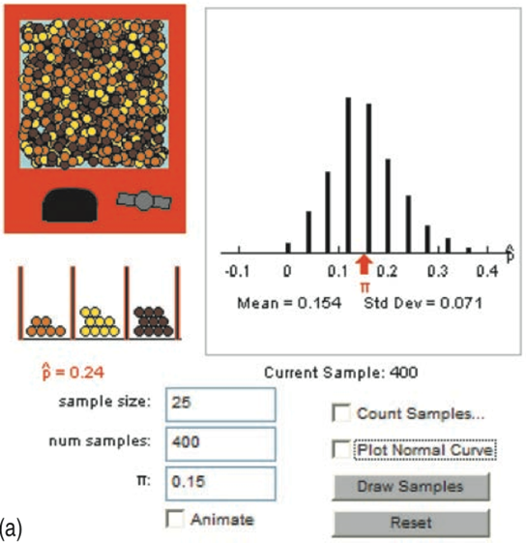
http://www.rossmanchance.com/applets/Reeses/ReesesPieces.html

Slide 4
The Sampling Distribution of
What do you notice about the shape, center, and spread of each?
n =100
n =400

Slide 5
Sample Proportion Formulas
The sample size MUST be less than 10% of the total population.

Slide 6
Normal Approximation & Sample Proportions
As the sample size increase, sample proportion approach the normal distribution; therefore, we can use Normal calculations.
Before using Normal calculation, check Normal conditions:
(sample size)(proportion) must be greater than 10.
(sample size)(1 – proportion) must be greater than 10.
Both must be greater than 10

Slide 7
Normal Approximation & Sample Proportions
In the game of Scrabble, each player starts by drawing 7 tiles from a bag of 100 tiles. There are 42 vowels, 56 constants and 2 blank tiles. Cait choses an SRS of 7 tiles. Let $\hat{p}$ be the proportion of vowels in her sample.
Is the 10% condition met? Justify your answer.
b) Is the Normal condition met? Justify your answer.

Slide 8
Normal Approximation & Sample Proportions
(a) Yes. Seven tiles is less than 10% of the population of 100 tiles.
(b) No. Since the total sample size was 7, both np and n(1-p) must be less than 10. The Normal condition is not satisfied.

Slide 9
Normal Approximation & Sample Proportions
A polling organization asks an SRS of 1500 first-year college students how far away their home is. Suppose that 35% of all first-year students actually attend college within 50 miles of home.
What is the probability that the random sample of 1500 students will give a result within 2 percentage points of this true value?

Slide 10
We have an SRS of size n = 1500 drawn from a population in which the proportion p = 0.35 attend college within 50 miles of home.
Conditions:
Independence: It is reasonable to assume that there are more than 15,000 college freshmen and therefore the sample represents less than 10% of the population.
Normality: Additionally, np = 1500(0.35) = 525 and n(1 – p) = 1500(0.65)=975 are both greater than 10, so it is reasonable to assume normality.

Slide 11
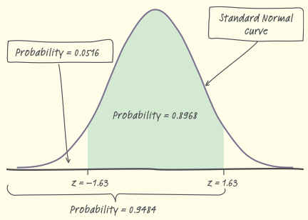
Normalcdf (0.33, 0.37, 0.35, 0.0123) = 0.896054
CONCLUDE: There is an 89.61% chance that the sample will yield results within 2 percentage points of the true value.

Slide 12
The Harvard College Alcohol Study finds that 67% of college students support efforts to “crack down on underage drinking.” The study took a random sample of almost 15,000 students, so the population proportion who support a crackdown is close to p = 0.67. The administration of a local college surveys an SRS of 100 students and finds that 62 support a crackdown on underage drinking. Suppose that the proportion of all students attending this college who support a crackdown is 67%, the same as the national proportion.
What is the probability that the proportion in an SRS of 100 students is as small as or smaller than the result of the administration’s sample?

Slide 13
Conditions:
Independence: It is reasonable to assume that there are more than 1000 college freshmen and therefore the sample represents less than 10% of the population.
Normality: Additionally, np = 100(0.67) = 67and n(1 – p) = 100(0.33)= 33 are both greater than 10, so it is reasonable to assume normality.

Slide 14
Normalcdf (0, 0.62, 0.67, 0.04702) = 0.143805
Be sure to include labels!
CONCLUDE: There is an 14.38% chance that the sample will yield results at or below 62% given that the true population proportions is 67%

Slide 15
FYI: Derivation of Formulas
In Chapter 6, we learned that the mean and standard deviation of a binomial random variable X are
As sample size increases, the spread decreases.

