Slide 1
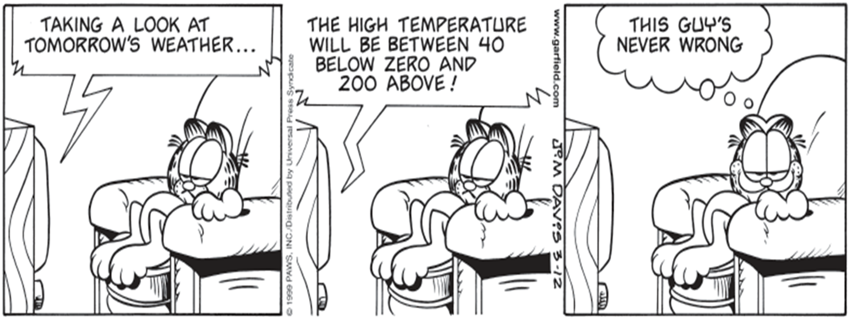
Section 8.1
Confidence Intervals: The Basics

Slide 2
Section 8.1 Confidence Intervals: The Basics
After this section, you should be able to…
INTERPRET a confidence level
INTERPRET a confidence interval in context
DESCRIBE how a confidence interval gives a range of plausible values for the parameter
DESCRIBE the inference conditions necessary to construct confidence intervals
EXPLAIN practical issues that can affect the interpretation of a confidence interval

Slide 3
Confidence Intervals
In this chapter, we’ll learn one method of statistical inference – confidence intervals – so we may
Estimate the value of a parameter from a sample statistic
Calculate probabilities that would describe what would happen if we used the inference method many times.
In Chapter 7 we assumed we knew the population parameter; however, in many real life situations, it is impossible to know the population parameter. Can we really weigh all the uncooked burgers in the US? Can we really measure the weights of all US citizens?

Slide 4
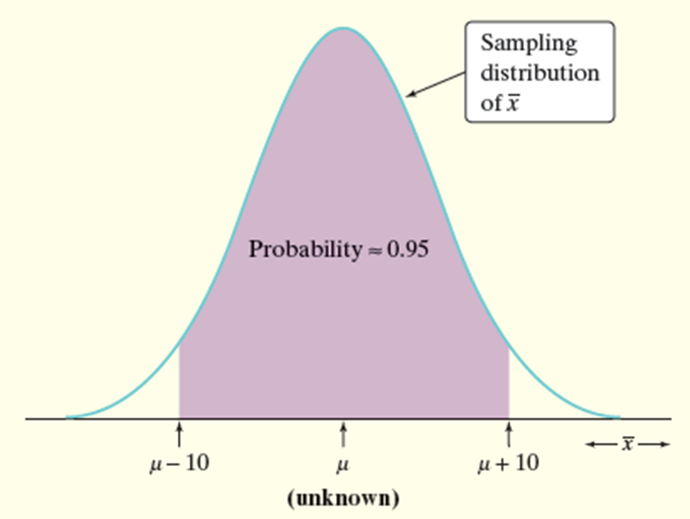
The Idea of a Confidence Interval
For example: Based on our SRS we find the mean height of 16 year girls to be 65.28 inches. Is the value of the population mean µ exactly 65.28 inches? Probably not.
However, since the sample mean is 65.28, we could guess that µ is “somewhere” around 65.28. How close to 240.79 is µ likely to be?

Slide 5
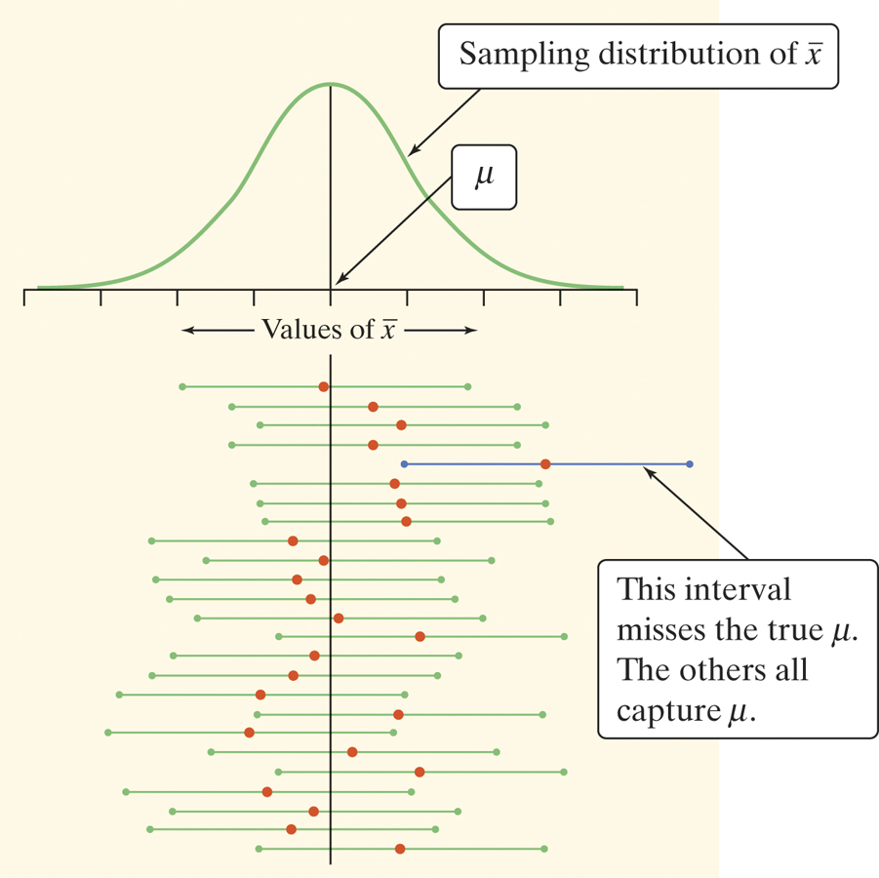
Confidence Intervals: The Basics

Slide 6
Confidence Intervals: Point Estimator
A point estimator is a statistic that provides an estimate of a population parameter. The value of that statistic from a sample is called a point estimate. Ideally, a point estimate is our “best guess” at the value of an unknown parameter.
The point estimator can be a potential mean, standard deviation, IQR, median, etc.

Slide 7
Identify the Point Estimators
(a) The golf ball manufacturer would also like to investigate the variability of the distance travelled by the golf balls by estimating the interquartile range.
(b) The math department wants to know what proportion of its students own a graphing calculator, so they take a random sample of 100 students and find that 28 own a graphing calculator.

Slide 8
Identify the Point Estimators
a. Use the sample IQR as the point estimate for the true IQR.
b. Use the sample proportion $\hat{p}$ as a point estimator for the true proportion p. The sample proportion is $\hat{p}$ = 0.28.

Slide 9
Confidence Intervals: The Basics
How would you describe the shape of this distribution?

Slide 10
Shape, Center & Spread

Slide 11
Confidence Intervals: Conditions
1) Random: The data should come from a well-designed random sample or randomized experiment.
2) Normal: The sampling distribution of the statistic is approximately Normal.
For proportions: We can use the Normal approximation to the sampling distribution as long as np ≥ 10 and n(1 – p) ≥ 10.
For means: The sampling distribution is exactly Normal if the population distribution is Normal. When the population distribution is not Normal, then the central limit theorem tells us the sampling distribution will be approximately Normal if n is sufficiently large (n ≥ 30).
3) Independent: Individual observations are independent. When sampling without replacement, the sample size n should be no more than 10% of the population size N (the 10% condition).

Slide 12
Confidence Intervals: Formulas
General Formula:
point estimator $±$ z-score $∙$ standard deviation of the statistic
CI Proportions:
$$\hat{p} ± z \sqrt{\frac{\hat{p}(1 − \hat{p})}{n}}$$
CI Means:
$\overline{x} ±$z ($\frac{σ}{\sqrt{n}}$)

Slide 13
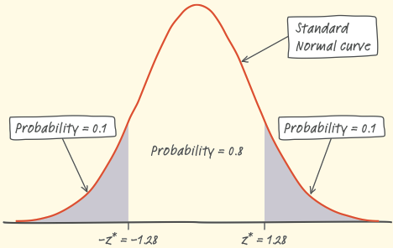
REVIEW: Finding a Critical Value
Use Table A to find the critical value z* for an 80% confidence interval. Assume that the Normal condition is met.
Since we want to capture the central 80% of the standard Normal distribution, we leave out 20%, or 10% in each tail.
Search Table A to find the point z* with area 0.1 to its left.
z | .07 | .08 | .09
– 1.3 | .0853 | .0838 | .0823
– 1.2 | .1020 | .1003 | .0985
– 1.1 | .1210 | .1190 | .1170
The closest entry is z = – 1.28.
So, the critical value z* for an 80% confidence interval is z* = 1.28.

Slide 14
Common Confidence Intervals & z-scores
Confidence Level | Z-Score
99% | 2.575
95% | 1.960
90% | 1.645
We usually choose a confidence level of 90% or higher because we want to be quite sure of our conclusions. The most common confidence level is 95%.

Slide 15
Interpreting Confidence Levels
The confidence level tells us how likely it is that the method we are using will produce an interval that captures the population parameter if we use it many times.
For Example: “In 95% of all possible samples of the same size, the resulting confidence interval would capture the true (insert details in context).”
The confidence level does NOT tell us the chance that a particular confidence interval captures the population parameter.
NO: There is a 95% chance that the mean is between….

Slide 16
Interpreting Confidence Intervals
Interpret: “We are 95% confident that the interval from ______ to _______ captures the actual value of the (insert population parameter details…)”
NOT There is a 95% percent chance….
For example: “We are 95% confident that the interval from 3.03 inches to 3.35 inches capture the actual mean amount of rain in the month of April in Miami.”

Slide 17
Interpret the Following…
According to www.gallup.com, on August 13, 2015, the 95% confidence interval for the true proportion of Americans who approved of the job Barack Obama was doing as president was 0.44 +/- 0.03.
Interpret the confidence interval and level.

Slide 18
Interpret the Following…
Interval: We are 95% confident that the interval from 0.41 to 0.47 captures the true proportion of Americans who approve of the job Barack Obama was doing as president at the time of the poll.
Level: In 95% of all possible samples of the same size, the resulting confidence interval would capture the true proportion of Americans who approve of the job Barack Obama was doing as president.

Slide 19
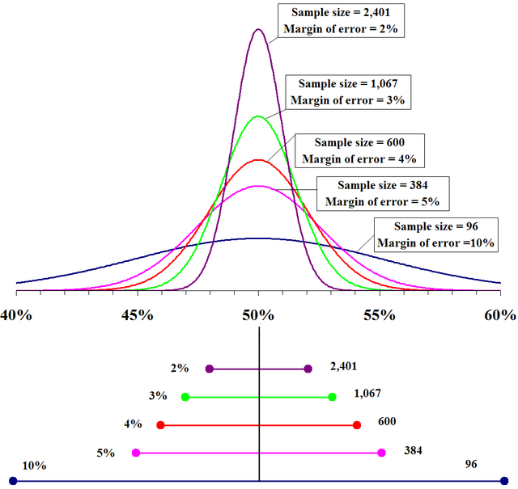
Confidence Intervals: Properties
The margin of error:
(critical value) • (standard deviation)
The margin of error gets smaller when:
The confidence level decreases
The sample size n increases

Slide 20
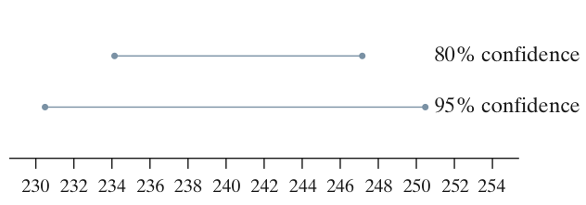
Confidence Intervals: Properties
The critical value (z-score) depends on the confidence level and the sampling distribution of the statistic.
Greater confidence requires a larger critical value
The standard deviation of the statistic depends on the sample size n

