Slide 1
Chapter 1
Data Analysis
Section 1.1
Analyzing Categorical Data

Slide 2
Data Analysis
CALCULATE marginal and joint relative frequencies from a two-way table.
CALCULATE conditional relative frequencies from a two-way table.
Use bar graphs to COMPARE distributions of categorical data.
DESCRIBE the nature of the association between two categorical variables.

Slide 3
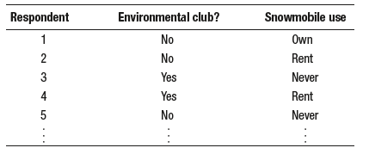
Analyzing Data on Two Categorical Variables
How do you analyze data do when a data set involves two categorical variables?

Slide 4
Analyzing Data on Two Categorical Variables
How do you analyze data do when a data set involves two categorical variables?
A two-way table is a table of counts that summarizes data on the relationship between two categorical variables for some group of individuals.

Slide 5
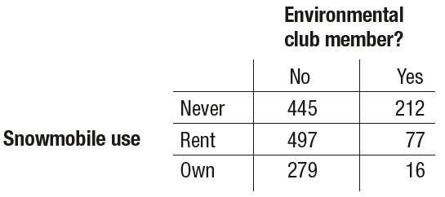
Analyzing Data on Two Categorical Variables
How do you analyze data do when a data set involves two categorical variables?
A two-way table is a table of counts that summarizes data on the relationship between two categorical variables for some group of individuals.

Slide 6
Analyzing Data on Two Categorical Variables
How do you analyze data do when a data set involves two categorical variables?
A two-way table is a table of counts that summarizes data on the relationship between two categorical variables for some group of individuals.
We can include row and column totals

Slide 7
Analyzing Data on Two Categorical Variables
A marginal relative frequency gives the percent or proportion of individuals that
have a specific value for one categorical variable.

Slide 8
Analyzing Data on Two Categorical Variables
A marginal relative frequency gives the percent or proportion of individuals that
have a specific value for one categorical variable.

Slide 9
Analyzing Data on Two Categorical Variables
A marginal relative frequency gives the percent or proportion of individuals that
have a specific value for one categorical variable.

Slide 10
Analyzing Data on Two Categorical Variables
A marginal relative frequency gives the percent or proportion of individuals that
have a specific value for one categorical variable.

Slide 11
Analyzing Data on Two Categorical Variables
A marginal relative frequency gives the percent or proportion of individuals that
have a specific value for one categorical variable.

Slide 12
Analyzing Data on Two Categorical Variables
A marginal relative frequency gives the percent or proportion of individuals that
have a specific value for one categorical variable.

Slide 13
Analyzing Data on Two Categorical Variables
A marginal relative frequency gives the percent or proportion of individuals that
have a specific value for one categorical variable.
A marginal relative frequency tells you about only one of the variables in a two-way table.

Slide 14
Analyzing Data on Two Categorical Variables
A joint relative frequency gives the percent or proportion of individuals that have a specific value for one categorical variable and a specific value for another categorical variable.

Slide 15
Analyzing Data on Two Categorical Variables
A joint relative frequency gives the percent or proportion of individuals that have a specific value for one categorical variable and a specific value for another categorical variable.
A joint relative frequency helps answer questions involving both of the variables in a two-way table.

Slide 16
Analyzing Data on Two Categorical Variables
A joint relative frequency gives the percent or proportion of individuals that have a specific value for one categorical variable and a specific value for another categorical variable.
What percent of people in the sample are environmental club members and own snowmobiles?
A joint relative frequency helps answer questions involving both of the variables in a two-way table.

Slide 17
Analyzing Data on Two Categorical Variables
A joint relative frequency gives the percent or proportion of individuals that have a specific value for one categorical variable and a specific value for another categorical variable.
What percent of people in the sample are environmental club members and own snowmobiles?
A joint relative frequency helps answer questions involving both of the variables in a two-way table.

Slide 18
Analyzing Data on Two Categorical Variables
A joint relative frequency gives the percent or proportion of individuals that have a specific value for one categorical variable and a specific value for another categorical variable.
What percent of people in the sample are environmental club members and own snowmobiles?
A joint relative frequency helps answer questions involving both of the variables in a two-way table.
What proportion of people in the sample are not environmental club members and never use snowmobiles?

Slide 19
Analyzing Data on Two Categorical Variables
A joint relative frequency gives the percent or proportion of individuals that have a specific value for one categorical variable and a specific value for another categorical variable.
What percent of people in the sample are environmental club members and own snowmobiles?
A joint relative frequency helps answer questions involving both of the variables in a two-way table.
What proportion of people in the sample are not environmental club members and never use snowmobiles?

Slide 20
Relationships Between Two Categorical Variables
Marginal and joint relative frequencies do not tell us much about the relationship between environmental club membership and snowmobile use for the people in the sample.

Slide 21
Relationships Between Two Categorical Variables
Marginal and joint relative frequencies do not tell us much about the relationship between environmental club membership and snowmobile use for the people in the sample.
A conditional relative frequency gives the percent or proportion of individuals that have a specific value for one categorical variable among individuals who
share the same value of another categorical variable (the condition).

Slide 22
Relationships Between Two Categorical Variables
Marginal and joint relative frequencies do not tell us much about the relationship between environmental club membership and snowmobile use for the people in the sample.
A conditional relative frequency gives the percent or proportion of individuals that have a specific value for one categorical variable among individuals who
share the same value of another categorical variable (the condition).
What percent of environmental club members in the sample are snowmobile owners?

Slide 23
Relationships Between Two Categorical Variables
Marginal and joint relative frequencies do not tell us much about the relationship between environmental club membership and snowmobile use for the people in the sample.
A conditional relative frequency gives the percent or proportion of individuals that have a specific value for one categorical variable among individuals who
share the same value of another categorical variable (the condition).
What percent of environmental club members in the sample are snowmobile owners?

Slide 24
Relationships Between Two Categorical Variables
Marginal and joint relative frequencies do not tell us much about the relationship between environmental club membership and snowmobile use for the people in the sample.
A conditional relative frequency gives the percent or proportion of individuals that have a specific value for one categorical variable among individuals who
share the same value of another categorical variable (the condition).
What percent of environmental club members in the sample are snowmobile owners?

Slide 25
Relationships Between Two Categorical Variables
The distribution of snowmobile use among environmental club members is called the conditional distribution of snowmobile use among environmental club members.

Slide 26
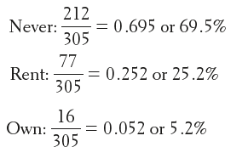
Relationships Between Two Categorical Variables
The distribution of snowmobile use among environmental club members is called the conditional distribution of snowmobile use among environmental club members.

Slide 27
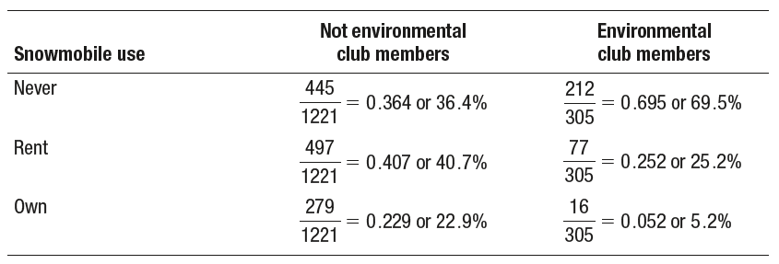
Relationships Between Two Categorical Variables
We can find the distribution of snowmobile use among the survey respondents who are not environmental club members in a similar way.

Slide 28
Relationships Between Two Categorical Variables
When comparing groups of different sizes, be sure to use relative frequencies (percents or proportions) instead of frequencies (counts) when analyzing categorical data.
Make sure to avoid statements like “More club members never use snowmobiles” when you mean “A greater percentage of club members never use snowmobiles.”

Slide 29
Relationships Between Two Categorical Variables
A side-by-side bar graph displays the distribution of a categorical variable for each value of another categorical variable. The bars are grouped together based
on the values of one of the categorical variables and placed side by side.
A segmented bar graph displays the distribution of a categorical variable as segments of a rectangle, with the area of each segment proportional to the
percent of individuals in the corresponding category.

Slide 30
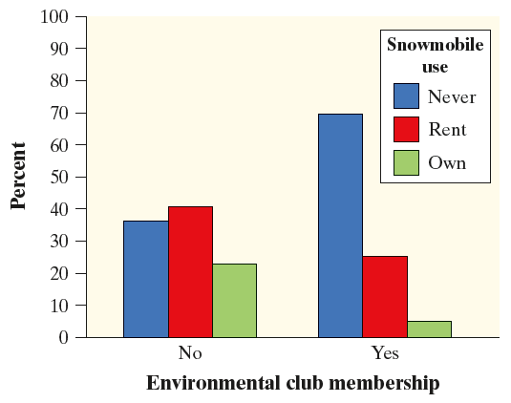
Relationships Between Two Categorical Variables
Side-by-side Bar Graph
A segmented bar graph displays the distribution of a categorical variable as segments of a rectangle, with the area of each segment proportional to the
percent of individuals in the corresponding category.

Slide 31
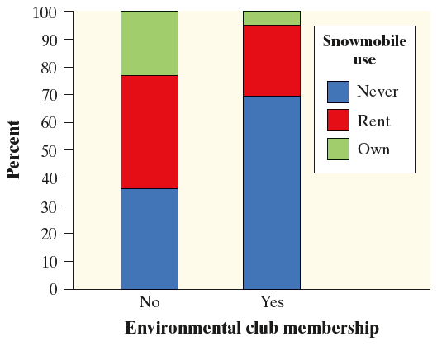
Relationships Between Two Categorical Variables
Side-by-side Bar Graph
Segmented Bar Graph

Slide 32
Relationships Between Two Categorical Variables
There is an association between two variables if knowing the value of one variable helps us predict the value of the other.

Slide 33
Relationships Between Two Categorical Variables
There is an association between two variables if knowing the value of one variable helps us predict the value of the other.

Slide 34
Relationships Between Two Categorical Variables
There is an association between two variables if knowing the value of one variable helps us predict the value of the other.
If knowing the value of one variable does not help us predict the value of the other, then there is no association between the variables.

Slide 35
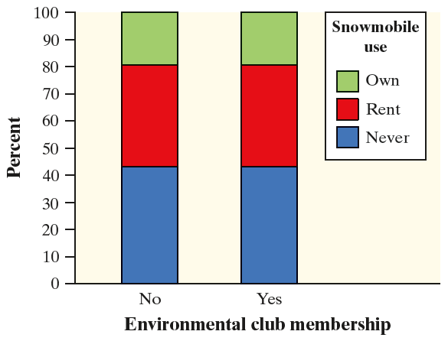
Relationships Between Two Categorical Variables
There is an association between two variables if knowing the value of one variable helps us predict the value of the other.
If knowing the value of one variable does not help us predict the value of the other, then there is no association between the variables.

Slide 36
Relationships Between Two Categorical Variables
There is an association between two variables if knowing the value of one variable helps us predict the value of the other.
CAUTION: Association does not necessarily imply causation!
If knowing the value of one variable does not help us predict the value of the other, then there is no association between the variables.

Slide 37
Section Summary
CALCULATE marginal and joint relative frequencies from a two-way table.
CALCULATE conditional relative frequencies from a two-way table.
Use bar graphs to COMPARE distributions of categorical data.
DESCRIBE the nature of the association between two categorical variables.

