Slide 1
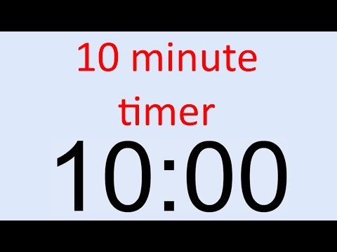
Bell Ringer Review
List the first 3 terms and the 50th term of the following sequence: $An=\frac{n+3}{n−3}$
Express the following sequence recursively and explicitly:
1, 3, 9, 27…
s

Slide 2
Convergent & Divergent Sequences

Slide 3
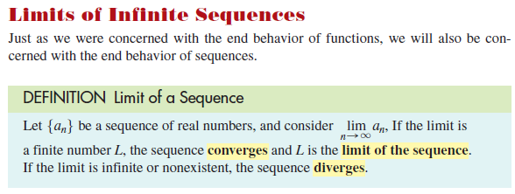

Slide 4
Example 1

Slide 5
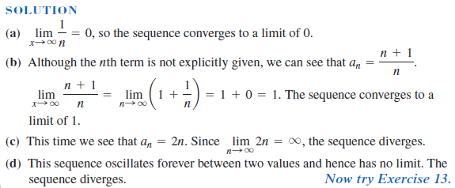

Slide 6
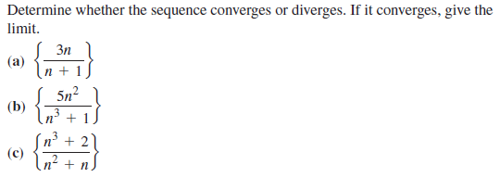
Example 2

Slide 7
