Slide 2
Extreme Values of Functions
Extreme Values of a function are created when the function changes from increasing to decreasing or from decreasing to increasing
Extreme value
•
increasing
decreasing
decreasing
increasing
•
Extreme value
Extreme value
Extreme value
Extreme value
dec
inc
inc
dec
inc
dec
dec
Extreme value
Extreme value

Slide 3
Extreme Values of Functions
Classifications of Extreme Values
Absolute Minimum – the smallest function value in the domain
Absolute Maximum – the largest function value in the domain
Local Minimum – the smallest function value in an open interval in the domain
Local Maximum – the largest function value in an open interval in the domain
Absolute Maximum
Local Maximum
Local Minimum
Absolute Minimum
Absolute Minimum
Local Maximum
Absolute Maximum
Local Maximum
Local Maximum
Local Maximum
Local Minimum
Local Minimum
Local Minimum
Local Minimum

Slide 4
Extreme Values of Functions
Definitions:
Absolute Minimum – occurs at a point c if $f(c)≤f(x)$ for x all values in the domain.
c
Absolute Minimum at c
Absolute Maximum – occurs at a point c if $f\left(c\right)≥f(x)$ for all x values in the domain.
c
Absolute Maximum at c
Local Minimum – occurs at a point c in an open interval, $(a,b)$, in the domain if $f(c)≤f(x)$ for all x values in the open interval.
a
c
b
Local Minimum at c
Local Maximum – occurs at a point c in an open interval, $(a,b)$, in the domain if $f(c)≥f(x)$ for all x values in the open interval.
a
c
b
Local Maximum at c

Slide 5
Extreme Values of Functions
The Extreme Value Theorem (Max-Min Existence Theorem)
If a function is continuous on a closed interval, [a, b], then the function will contain both an absolute maximum value and an absolute minimum value.
$$f(a)$$
$$f(b)$$
$$f(c)$$
a
c
b
Absolute maximum value: f(a)
Absolute minimum value: f(c)

Slide 6
Extreme Values of Functions
The Extreme Value Theorem (Max-Min Existence Theorem)
If a function is continuous on a closed interval, [a, b], then the function will contain both an absolute maximum value and an absolute minimum value.
$$f(c)$$
$$f(b)$$
$$f(a)$$
$$f(d)$$
a
c
d
b
Absolute maximum value: f(c)
Absolute minimum value: f(d)

Slide 7
Extreme Values of Functions
The Extreme Value Theorem (Max-Min Existence Theorem)
If a function is continuous on a closed interval, [a, b], then the function will contain both an absolute maximum value and an absolute minimum value.
$$f\left(c\right): DNE$$
F is not continuous at c.
$$f(b)$$
Theorem does not apply.
$$f(a)$$
$$f(d)$$
a
c
d
b
Absolute maximum value: none
Absolute minimum value: f(d)

Slide 8
Extreme Values of Functions
The Extreme Value Theorem (Max-Min Existence Theorem)
If a function is continuous on a closed interval, [a, b], then the function will contain both an absolute maximum value and an absolute minimum value.
$$f\left(c\right)$$
•
F is not continuous at c.
$$f(b)$$
Theorem does not apply.
$$f(a)$$
$$f(d)$$
a
c
d
b
Absolute maximum value: f(c)
Absolute minimum value: f(d)

Slide 9
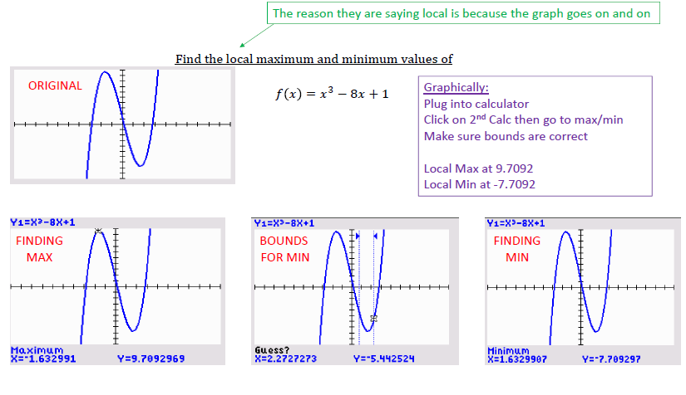

Slide 11
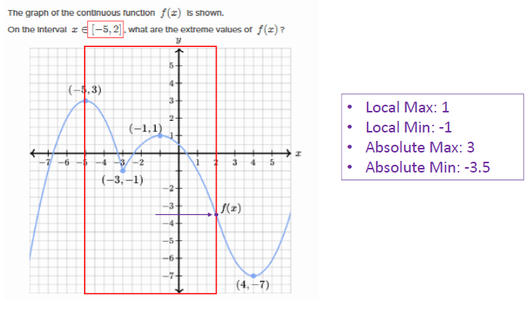

Slide 12
