Slide 1
Section 4.6. Graphs of Other Trigonometric Functions
What you should learn
Sketch the graphs of tangent functions.
• Sketch the graphs of cotangent
functions.
• Sketch the graphs of secant and
cosecant functions.

Slide 2
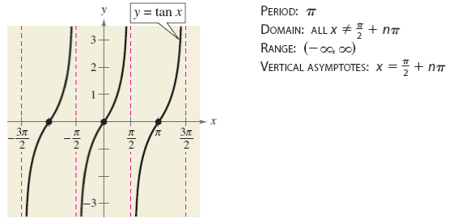
Graph of the Tangent Function y = tan x
Recall that the tangent function is odd, thus tan (-x) = -tan x. Therefore, the graph of y = tan x is symmetric with respect to the origin.

Slide 3
Transforming a Tangent Function y = a tan (bx - c)
Two consecutive vertical asymptotes can be found by solving the equations
bx – c = - π/2 and bx – c = π/2
The period of the function y = a tan (bx - c) is the distance between two consecutive vertical asymptotes.
The midpoint between two vertical asymptotes is an x-intercept of the graph.
The amplitude of the tangent function is undefined.

Slide 4
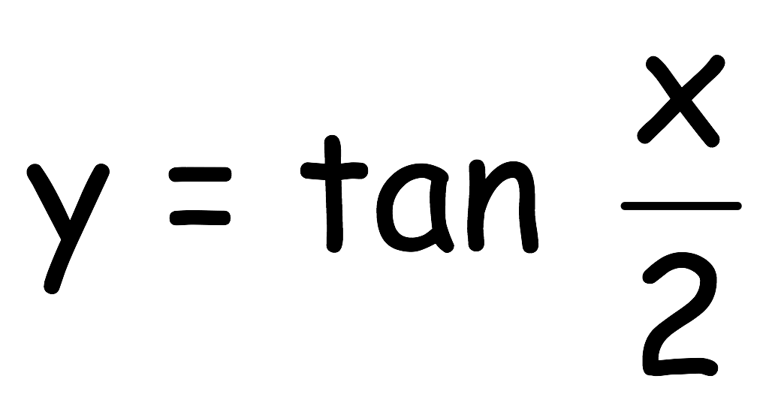
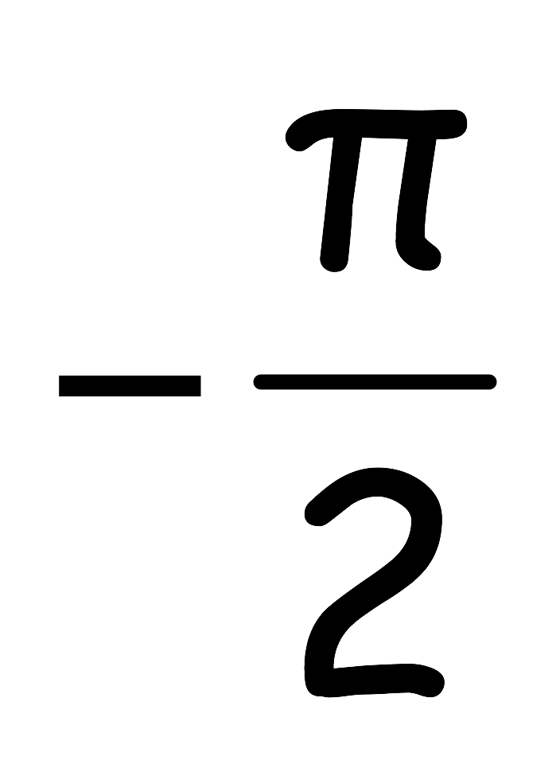
Example 1. Sketching the Graph of a Tangent Function
x | -π |  | 0 |  | π
tan x/2 | Und. | -1 | 0 | 1 | Und.

Slide 5
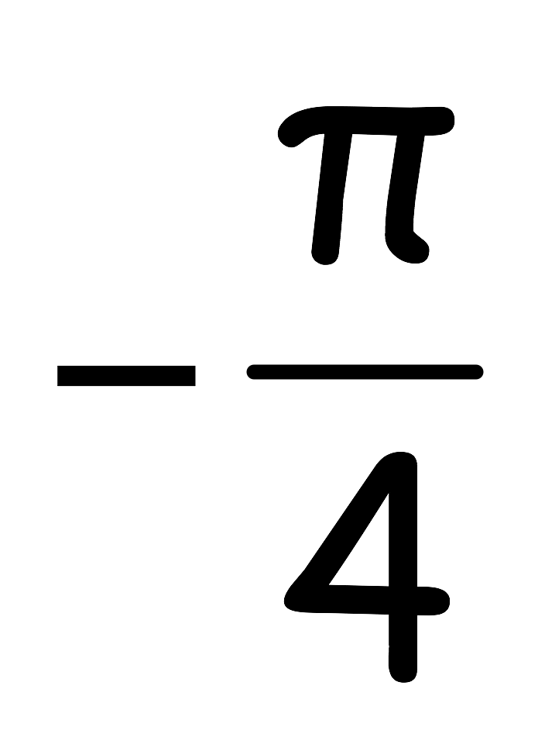
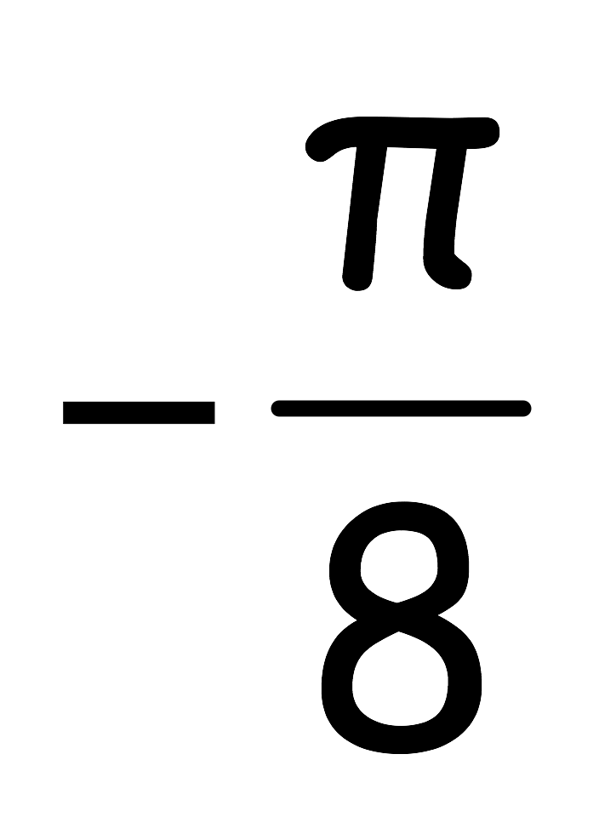
Example 2. Sketching the Graph of a Tangent Function
x |  |  | 0
-3 tan2x | Und. | 3 | 0 | -3 | Und.

Slide 6
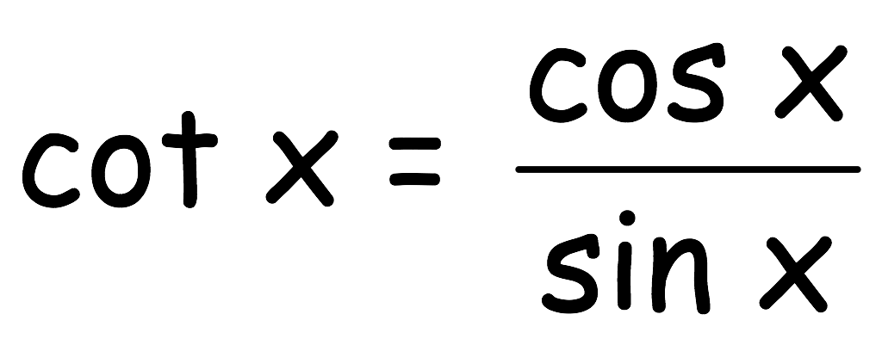
Graph of the Cotangent Function
The graph of the cotangent function is similar to the graph of the tangent function.
It has a period of π.
Since ,
The cotangent function has vertical asymptotes when sin x is zero, which occurs at x = nπ, where n is an integer

Slide 7
Compare and Contrast Tangent and Cotangent
Notes:
Teacher lead discussion

Slide 8
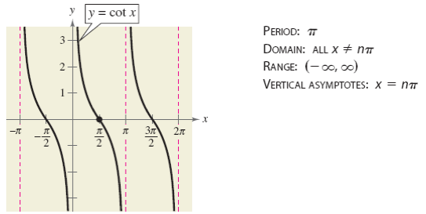
Graph of the Cotangent Function
Two consecutive vertical asymptotes can be found by solving the equations
bx – c = 0 and bx – c = π

Slide 9
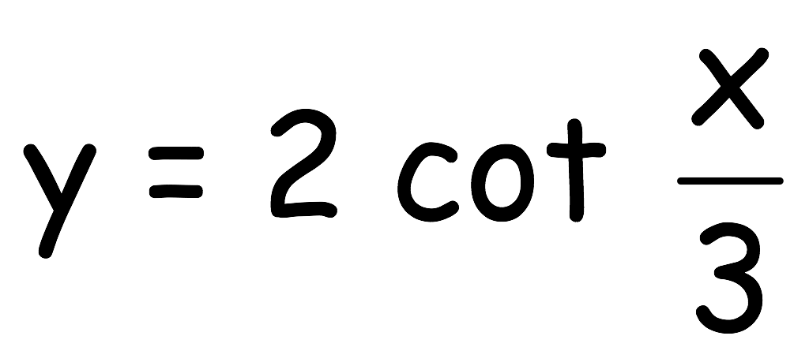
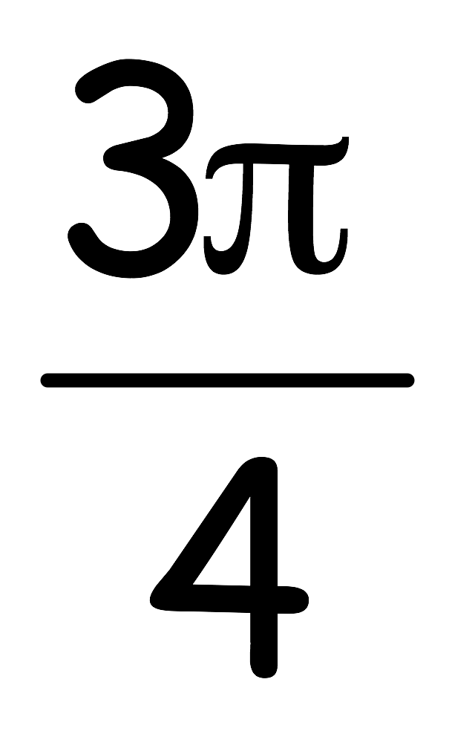
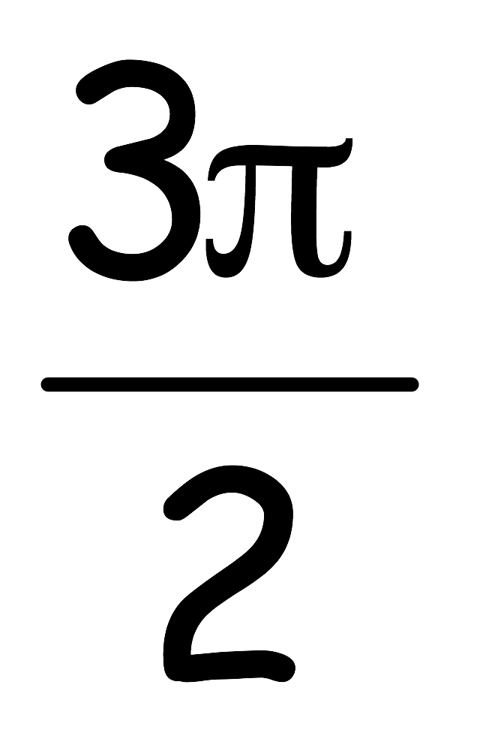
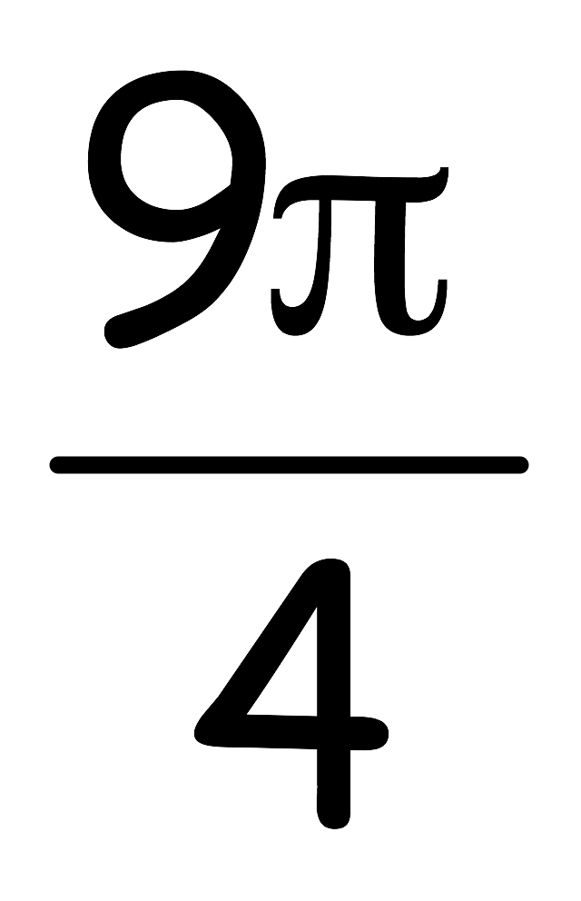
Example 3. Sketching the Graph of a Cotangent Function
x | 0 |  |  |  | 3π
2 cot x/3 | Und. | 2 | 0 | -2 | Und.

Slide 10
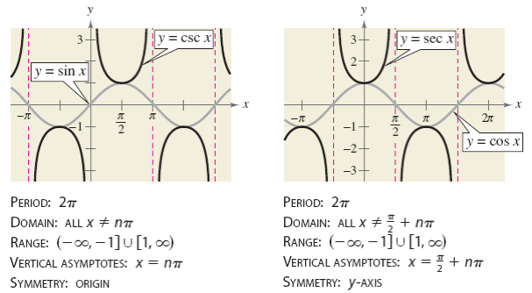
Graphs of the Reciprocal Functions

Slide 11
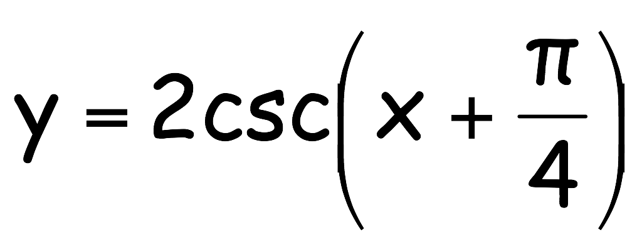
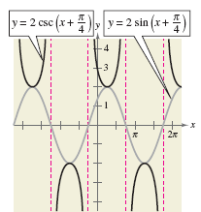
Graph of the Cosecant Function
Sketch the graph of:

Slide 12
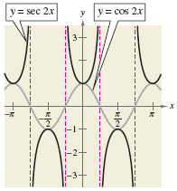
Graph of the Secant Function
Sketch the graph of: y = sec 2x

