Slide 1
Significance Testing for Comparing Two Means

Slide 2
Comparing Two Means
After this section, you should be able to…
DETERMINE whether the conditions for performing inference are met
USE two-sample t procedures to compare two means based on summary statistics or raw data
INTERPRET computer output for two-sample t procedures
PERFORM a significance test to compare two means
INTERPRET the results of inference procedures
ANALYZE the distribution of differences in a paired data set using graphs and summary statistics
DETERMINE when it is appropriate to use paired t procedures vs. two sample t procedures.

Slide 3
Significance Tests for µ₁ – µ₂
An observed difference between two sample means can reflect an actual difference in the parameters, or it may just be due to chance variation in random sampling or random assignment.
Significance tests help us decide which explanation makes more sense.
The null hypothesis has the general form: H₀: µ₁ = µ₂
The alternative hypothesis says what kind of difference we expect:
H_{a}: µ₁ > µ₂ OR H_{a}: µ₁ < µ₂ OR H_{a}: µ₁ ≠ µ₂

Slide 4
Formula: Significance Tests for
µ₁ – µ₂
The degrees of freedom is determined by smaller of n₁ - 1 and n₂ – 1.

Slide 5
Conditions: Two Mean T- Significance Test
1) Random: Both sets of data should come from a well-designed random samples or randomized experiments.
2) Normal: Both sets of data must meet the Central Limit Theorem* with sample sizes greater than 30 or graph values that are less than 30 to check normality. No crazy outliers!
3) Independent: Both sets of data must be independent. When sampling without replacement, the sample size n should be no more than 10% of the population size N (the 10% condition). Must check the condition for each separate sample.

Slide 6
Using the Two-Sample t Procedures: The Normal Condition
Sample size less than 15: Use two-sample t procedures if the data in both samples/groups appear close to Normal (roughly symmetric, single peak, no outliers). If the data are clearly skewed or if outliers are present, do not use t.
• Sample size at least 15: Two-sample t procedures can be used except in the presence of outliers or STRONG skewness.
• Large samples: The two-sample t procedures can be used even for clearly skewed distributions when both samples/groups are large, roughly n ≥ 30.

Slide 7
Tardy Policies
Mr. Lugo and Mr. Hart are trying two new, different tardy policy systems with a randomly selected group of habitually tardy students.
Mr. Lugo wants to know if his method resulted in a greater
decrease in the number of tardies. Assume there are at least 210 habitually tardy students at BTW.
A negative value represents a net decrease in number of tardies from quarter 2 to quarter 3. (Fewer tardies are better.)
Hart
Lugo

Slide 8
Parameters & Hypotheses:
H₀: µ₁ = µ₂
H_{a}: µ₁ > µ₂
µ₁ = the true mean decrease in tardies using Hart’s method
µ₂ = the true mean decrease in tardies using Lugo’s method
We will use α = 0.05.

Slide 9
Assess Conditions:
• Random: The 21 students were randomly assigned to the two treatments.
• Normal: Since the sample sizes are less than 15, we must check and draw graphs.
• Independent: Due to the random assignment, these two groups of students can be viewed as independent.
The boxplots show no clear evidence of skewness and no outliers, therefore we can use t procedures.

Slide 10
Name the Test: Two-sample t test for the difference µ₁ – µ₂.
Test Statistic: t = 1.634 or 1.60372 (calc)
Obtain p-value: p-value: 0.059348 or 0.06442 (calc)
` df= 9 or 15.5905 (calc)

Slide 11
Make Decision: Because the P-value, 0.06442, is greater than α = 0.05, we fail to reject the null hypothesis.
State Conclusion: There is not convincing evidence that Mr. Lugo’s method yielded a statistically significant decrease in the number of tardies.

Slide 12
Confidence Interval vs. Significance Test
To get results that are consistent with the one-tailed test at α = 0.05 from the example, we’ll use a 90% confidence level.
We are 90% confident that the interval from 0.4766 to -11.022 captures the difference in true mean decrease in tardies.
Because the 90% confidence interval includes 0 as a plausible value for the difference, we fail to reject the null hypothesis.

Slide 13
Using Two-Sample t Procedures Wisely
In planning a two-sample study, choose equal sample sizes if you can.
Do not use “pooled” two-sample t procedures!
We are safe using two-sample t procedures for comparing two means in a randomized experiment.
Do not use two-sample t procedures on paired data!
Beware of making inferences in the absence of randomization. The results may not be generalized to the larger population of interest.

Slide 14
Comparing Two Means: Paired Data

Slide 15
Section 10.3 Comparing Two Means: Paired Data
After this section, you should be able to…

Slide 16
Inference for Means: Paired Data
Study designs that involve making two observations on the same individual, or one observation on each of two similar individuals, result in paired data.
When paired data result from measuring the same quantitative variable twice, we can make comparisons by analyzing the differences in each pair.
If the conditions for inference are met, we can use one-sample t procedures to perform inference about the mean difference µ_{d}.
These methods are called paired t procedures.

Slide 17
Examples of Matched Pairs
Adopted twins into high (A) and low income(B) families; comparing Twin A IQ vs. Twin B IQ
Multiplication Test Score with music playing vs. without music playing
Test for Salmonella in 10 different eggs using two methods; compare measurements

Slide 18

Formulas
Significance Test:
t = $\frac{\overline{\overline{x} diff− 0} }{\frac{s diff}{\sqrt{n diff}} }$

Slide 19
Caffeine: Paired Data
Researchers designed an experiment to study the effects of caffeine withdrawal. They recruited 11 volunteers who were diagnosed as being caffeine dependent to serve as subjects.
Each subject was barred from coffee, colas, and other substances with caffeine for the duration of the experiment. During one two-day period, subjects took capsules containing their normal caffeine intake. During another two-day period, they took placebo capsules.
The order in which subjects took caffeine and the placebo was randomized. At the end of each two-day period, a test for depression was given to all 11 subjects.
Researchers wanted to know whether being deprived of caffeine would lead to an increase in depression. A higher value equals higher levels of depression.
Data on next slide.

Slide 20
Results of a caffeine deprivation study
Subject | Depression (caffeine) | Depression (placebo) | Difference (placebo – caffeine)
1 | 5 | 16 | 11
2 | 5 | 23 | 18
3 | 4 | 5 | 1
4 | 3 | 7 | 4
5 | 8 | 14 | 6
6 | 5 | 24 | 19
7 | 0 | 6 | 6
8 | 0 | 3 | 3
9 | 2 | 15 | 13
10 | 11 | 12 | 1
11 | 1 | 0 | - 1

Slide 21
State Parameters & State Hypothesis:
If caffeine deprivation has no effect on depression, then we would expect the actual mean difference in depression scores to be 0.
Parameter: µ_{d} = the true mean difference (placebo – caffeine) in depression score.
Hypotheses:
H₀: µ_{d} = 0
H_{a}: µ_{d} > 0
Since no significance level is given, we’ll use α = 0.05.

Slide 22
Assess Conditions:
Random researchers randomly assigned the treatment order—placebo then caffeine, caffeine then placebo—to the subjects.
Normal We don’t know whether the actual distribution of difference in depression scores (placebo - caffeine) is Normal. So, with such a small sample size (n = 11), we need to examine the data
Independent We aren’t sampling, so it isn’t necessary to check the 10% condition. We will assume that the changes in depression scores for individual subjects are independent. This is reasonable if the experiment is conducted properly.
The boxplot shows some right-skewness but no outliers; with no outliers or strong skewness, the t procedures are reasonable to use.

Slide 23
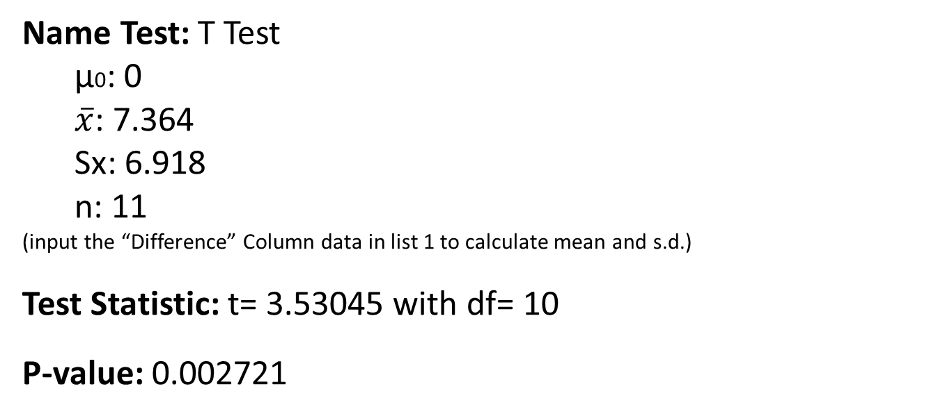
Name Test, Test Statistic (Calculate) and Obtain P-value

Slide 24
Make Decision & State Conclusion:
Make Decision: Since the P-value of 0.0027 is much less than α = 0.05, we have convincing evidence to reject H₀: µ_{d} = 0.
State Conclusion: We can therefore conclude that depriving these caffeine-dependent subjects of caffeine caused* an average increase in depression scores.
*Since the data came from a well-designed experiment we can use the word “caused”

