Slide 1
Extrema on an Interval
Section 3.1

Slide 2
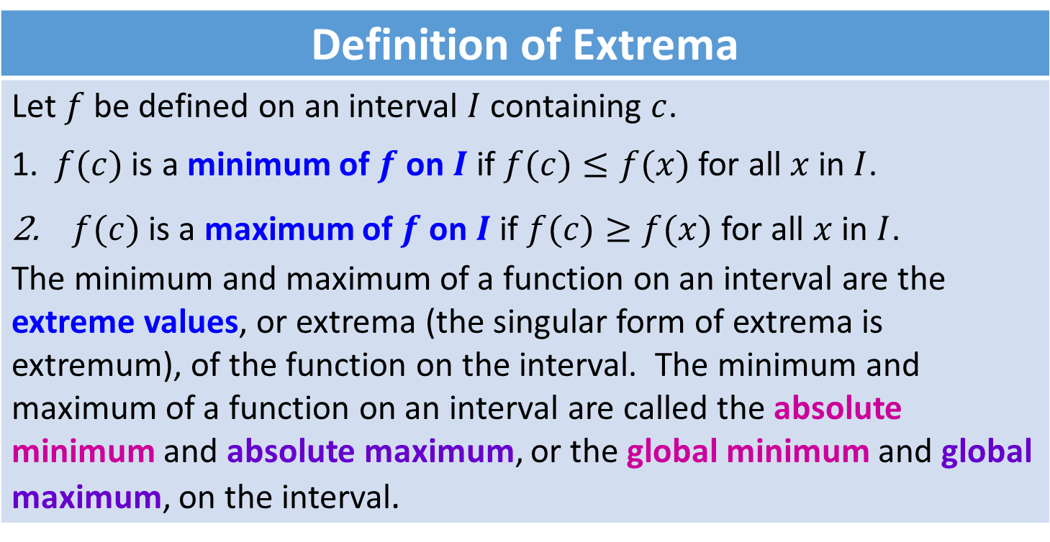
Definition of Extrema
Let $f$ be defined on an interval $I$ containing $c$. 1. $f(c)$ is a minimum of $f$ on $I$ if $f(c)≤f(x)$ for all $x$ in $I$. $f(c)$ is a maximum of $f$ on $I$ if $f(c)≥f(x)$ for all $x$ in $I$. The minimum and maximum of a function on an interval are the extreme values, or extrema (the singular form of extrema is extremum), of the function on the interval. The minimum and maximum of a function on an interval are called the absolute minimum and absolute maximum, or the global minimum and global maximum, on the interval.

Slide 3
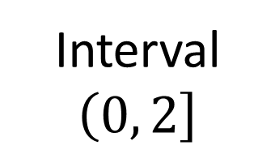


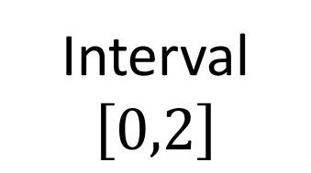

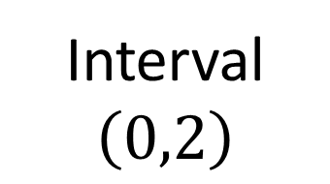
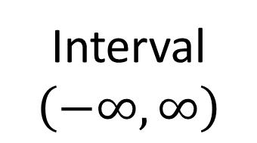

$$f\left(x\right)=x^{2}$$
$$f\left(x\right)=x^{2}$$
$$f\left(x\right)=x^{2}$$
$$f\left(x\right)=x^{2}$$
Interval
$$\left(−∞,∞\right)$$
Interval
$$\left[0,2\right]$$
Interval
$$\left(0,\left.2\right]\right.$$
Interval
$$\left(0,2\right)$$
Notes:
In the first diagram $f\left(x\right)$ only has an absolute minimum.
On the second diagram $f\left(x\right)$ has both an absolute maximum and absolute minimum.
On the third diagram $f\left(x\right)$ only has an absolute maximum.
On the last diagram $f\left(x\right)$ has neither an absolute maximum or absolute minimum.
On this slide students are suppose to come to the conclusion that when the interval is closed a function will have both an absolute maximum and absolute minimum.

Slide 4
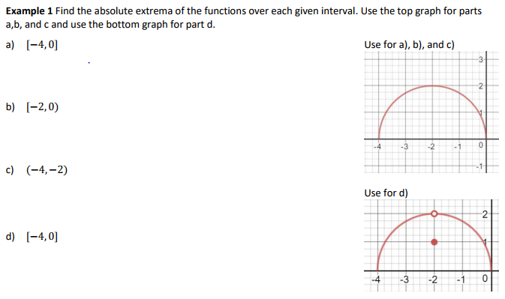
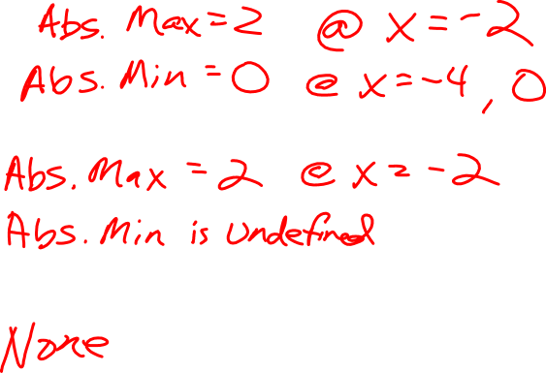

Slide 5
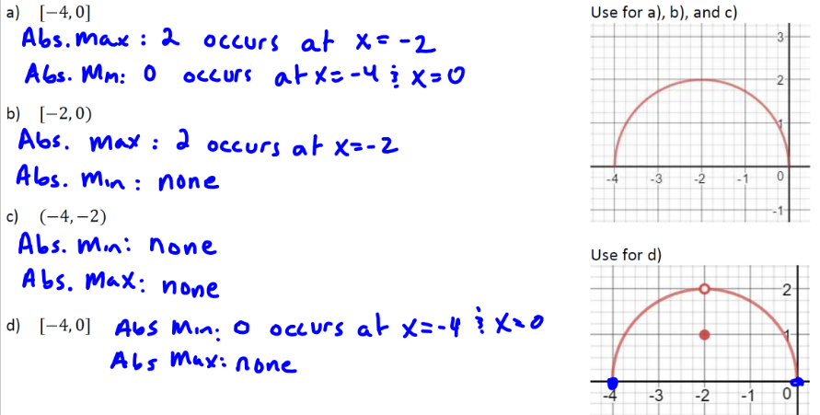

Slide 6
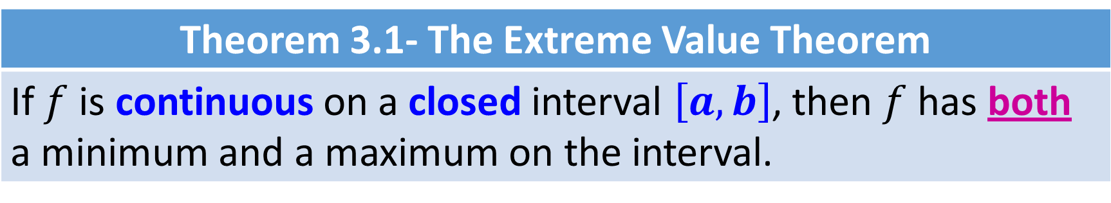
Theorem 3.1- The Extreme Value Theorem
If $f$ is continuous on a closed interval $\left[a,b\right]$, then $f$ has both a minimum and a maximum on the interval.

Slide 7
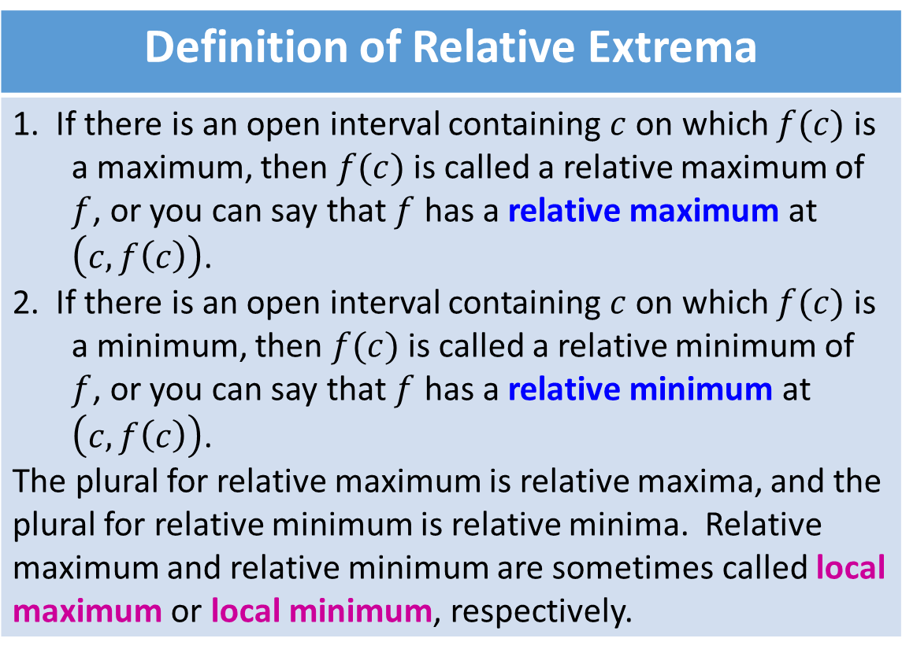
Definition of Relative Extrema
1. If there is an open interval containing $c$ on which $f(c)$ is a maximum, then $f(c)$ is called a relative maximum of $f$, or you can say that $f$ has a relative maximum at $\left(c,f\left(c\right)\right)$. 2. If there is an open interval containing $c$ on which $f(c)$ is a minimum, then $f(c)$ is called a relative minimum of $f$, or you can say that $f$ has a relative minimum at $\left(c,f\left(c\right)\right)$. The plural for relative maximum is relative maxima, and the plural for relative minimum is relative minima. Relative maximum and relative minimum are sometimes called local maximum or local minimum, respectively.

Slide 8
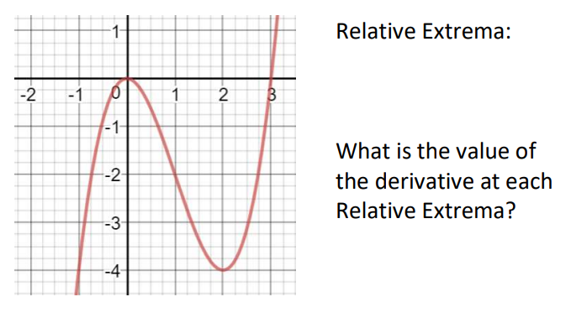
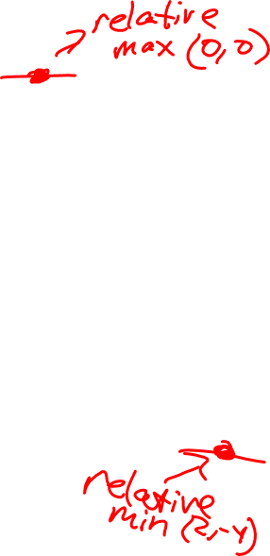

Slide 9
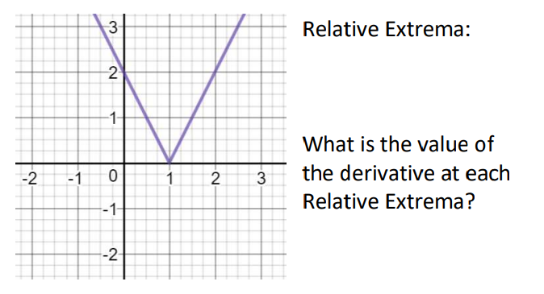
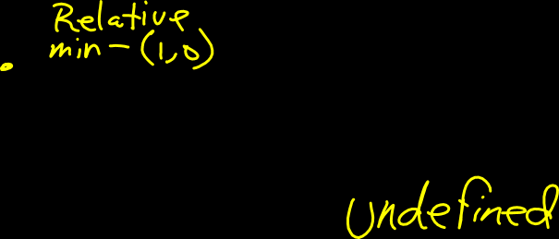

Slide 10
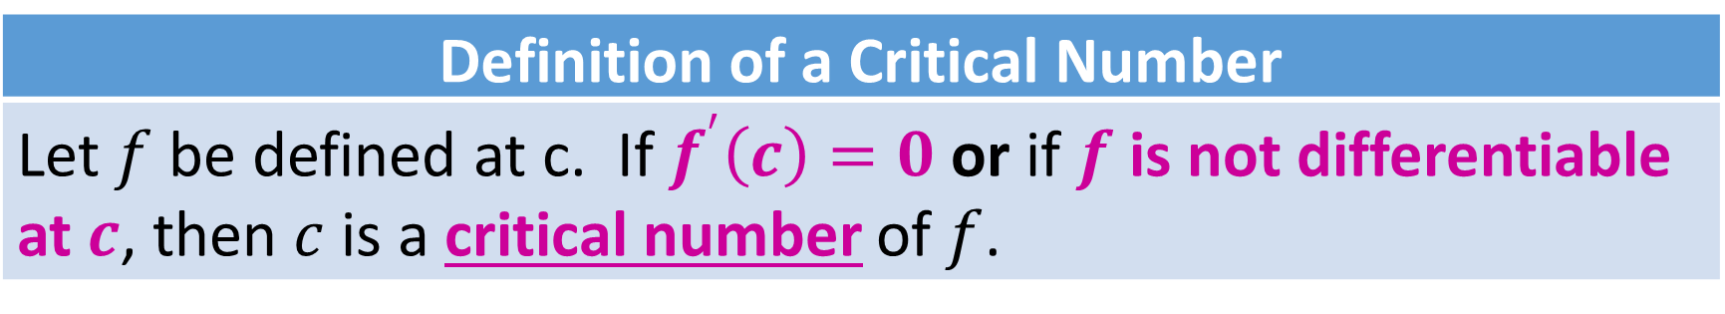
Definition of a Critical Number
Let $f$ be defined at c. If $f^{′}\left(c\right)=0$ or if $f$ is not differentiable at $c$, then $c$ is a critical number of $f$.

Slide 11
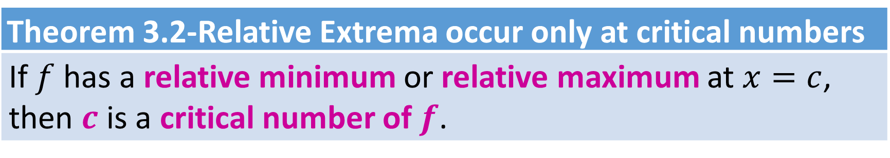
Theorem 3.2-Relative Extrema occur only at critical numbers
If $f$ has a relative minimum or relative maximum at $x=c$, then $c$ is a critical number of $f$.

Slide 12
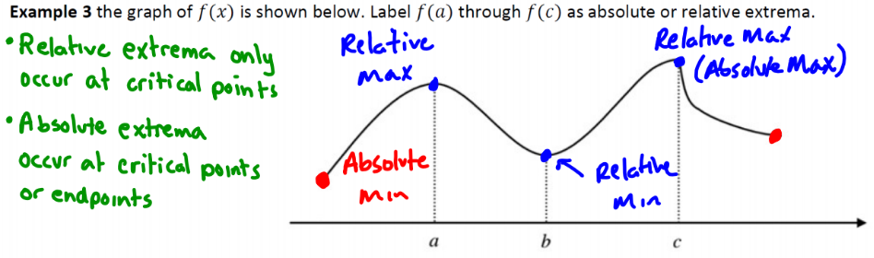

Slide 13
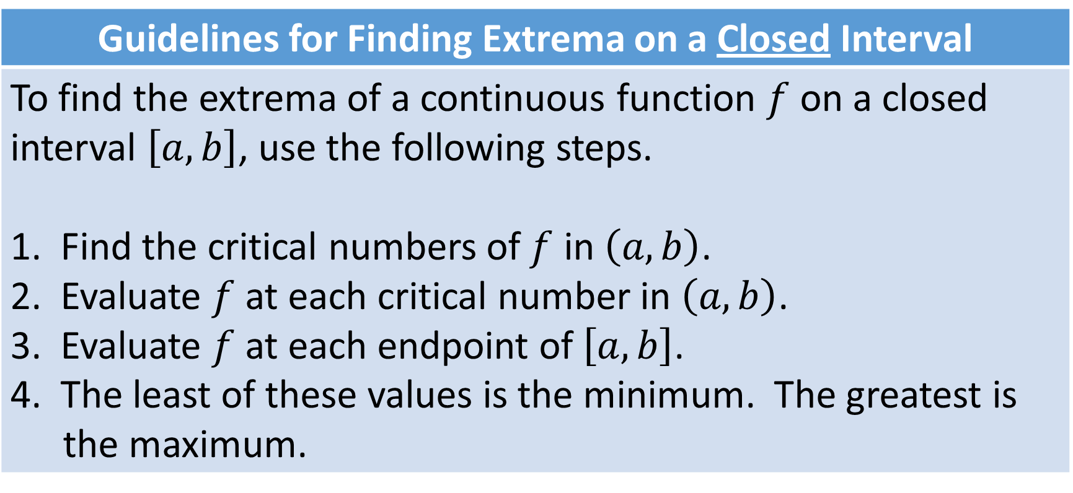
Guidelines for Finding Extrema on a Closed Interval
To find the extrema of a continuous function $f$ on a closed interval $\left[a,b\right]$, use the following steps. 1. Find the critical numbers of $f$ in $\left(a,b\right)$. 2. Evaluate $f$ at each critical number in $\left(a,b\right)$. 3. Evaluate $f$ at each endpoint of $\left[a,b\right]$. 4. The least of these values is the minimum. The greatest is the maximum.
Make a table

Slide 14
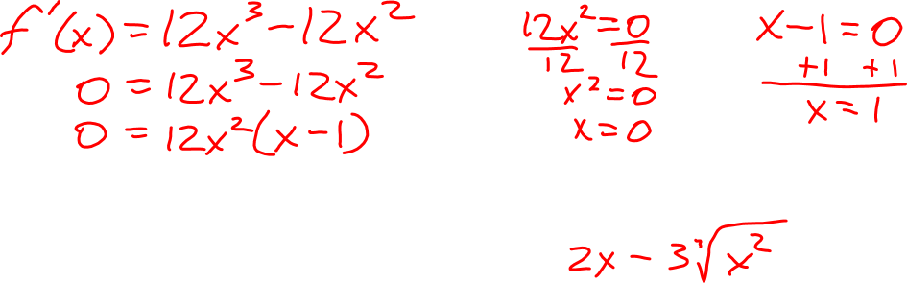

Slide 15

Example:
1) $f\left(x\right)=\frac{1}{x}+\ln{x}$ $\left[\frac{1}{2},4\right]$

Slide 16


Example:
2) $f\left(x\right)=\sin\left(x+\frac{π}{4}\right)$ $\left[\frac{π}{2},\frac{7π}{4}\right]$
$\frac{π}{4}$ $\frac{π}{2}$ $\frac{3π}{4}$ $π$ $\frac{5π}{4}$ $\frac{3π}{2}$ $\frac{7π}{4}$

Slide 17
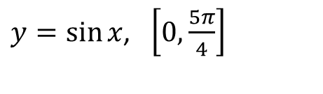
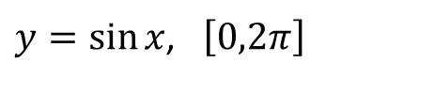


On a closed interval a continuous function has both an absolute maximum and absolute minimum.
$y=\sin{x}$, $\left[0,2π\right]$
$y=\sin{x}$, $\left[\frac{3π}{4},2π\right]$
$y=\sin{x}$, $\left[0,\frac{5π}{4}\right]$
$y=\sin{x}$, $\left[\frac{3π}{4},\frac{5π}{4}\right]$
Absolute Maximum at Critical #
Absolute Minimum at Critical #
Absolute Maximum at an endpoint
Absolute Minimum at Critical #
Absolute Maximum at Critical #
Absolute Minimum at an endpoint
Absolute Maximum at an endpoint
Absolute Minimum at an endpoint

