Slide 1
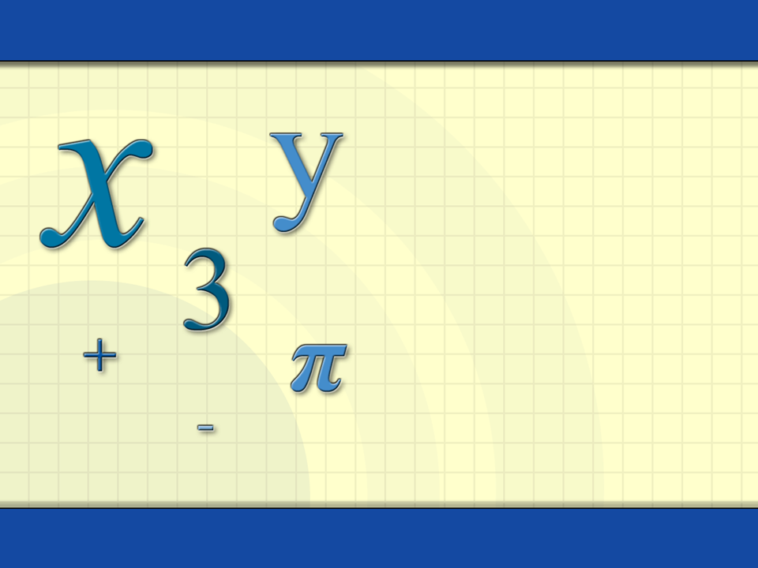
Polar Coordinates and Graphs of Polar Equations
Digital Lesson

Slide 2

Definition: Polar Coordinate System
The polar coordinate system is formed by fixing a point, O, which is the pole (or origin).
The polar axis is the ray constructed from O.
Each point P in the plane can be assigned polar coordinates (r, θ).
P = (r, θ)
r = directed distance
O
θ = directed angle
Polar axis
Pole (Origin)
r is the directed distance from O to P.
θ is the directed angle (counterclockwise) from the polar axis to OP.

Slide 3
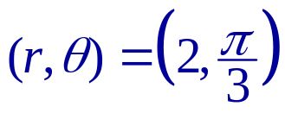
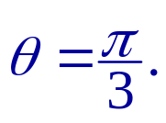

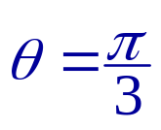
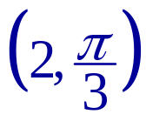

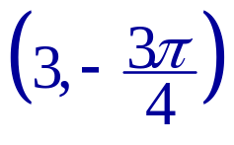
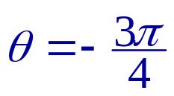

Plotting Points
Plotting Points
The point lies two units from the pole on the terminal side of the angle
0
1
2
3
3 units from the pole

Slide 4
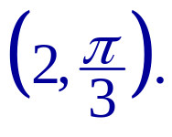
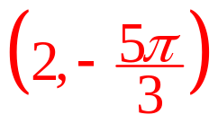
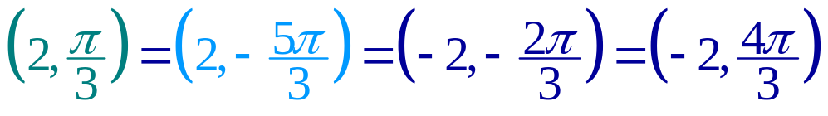
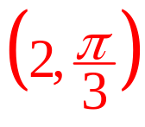


Multiple Representations of Points
There are many ways to represent the point
additional ways to represent the point
0
1
2
3

Slide 5
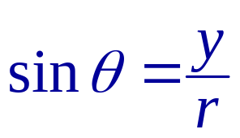
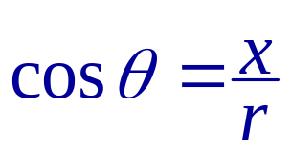
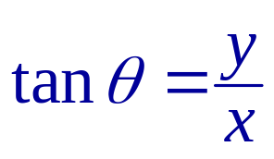
Polar and Rectangular Coordinate
The relationship between rectangular and polar coordinates is as follows.
y
The point (x, y) lies on a circle of radius r, therefore, r² = x² + y².
(x, y)
Definitions of trigonometric functions
(r, θ)
r
y
Pole
θ
x
(Origin)
x

Slide 6

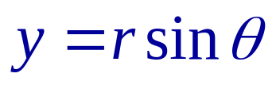
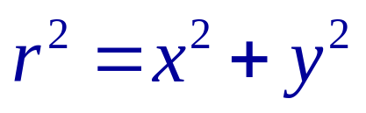
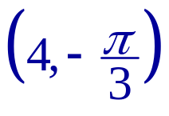
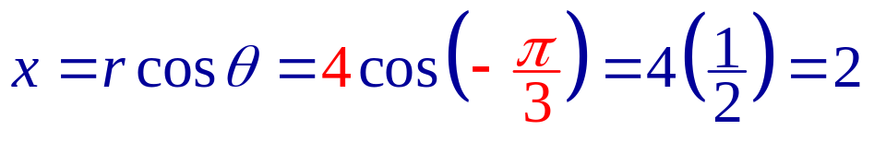
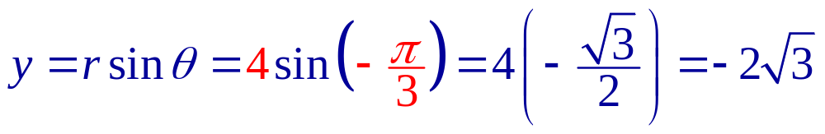
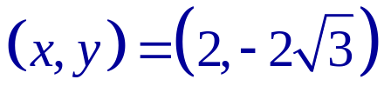
Example: Coordinate Conversion
Coordinate Conversion
(Pythagorean Identity)
Example:
Convert the point into rectangular coordinates.

Slide 7
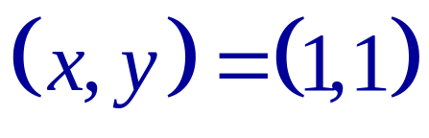
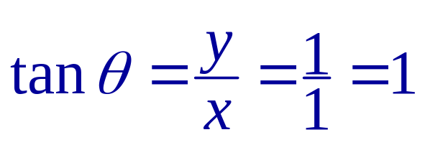
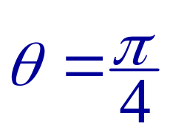
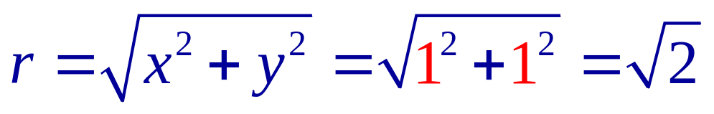
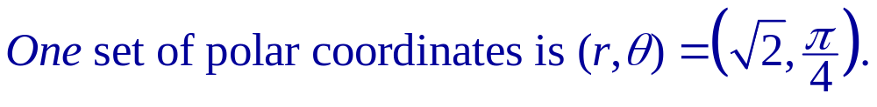
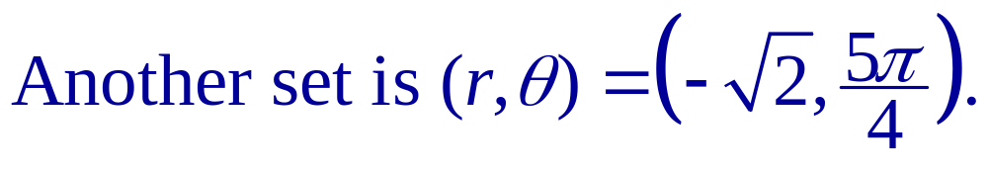
Example: Coordinate Conversion
Example:
Convert the point (1,1) into polar coordinates.

Slide 8

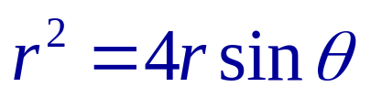
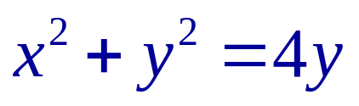
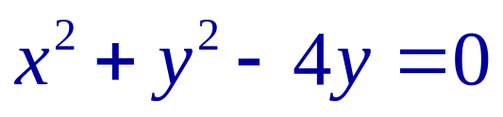
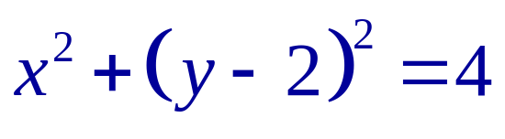
Example: Converting Polar Equations to Rectangular
Example:
Convert the polar equation into a rectangular equation.
Polar form
Multiply each side by r.
Substitute rectangular coordinates.
Equation of a circle with center (0, 2) and radius of 2

Slide 9












Graphs of Polar Equations
Example:
Graph the polar equation r = 2cos θ.
θ
r
0
2
1
0
–1
0
1
2
3
–2
The graph is a circle of radius 2 whose center is at point (x, y) = (0, 1).
0
2

Slide 10
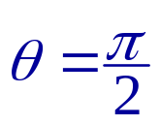
Definition: Symmetry of Polar Graphs
If substitution leads to equivalent equations, the graph of a polar equation is symmetric with respect to one of the following.
1. The line
Replace (r, θ ) by (r, π – θ ) or (–r, –θ ).
2. The polar axis
Replace (r, θ ) by (r, –θ ) or (–r, π –θ ).
3. The pole
Replace (r, θ ) by (r, π + θ ) or (–r, θ ).
Example:
The graph is symmetric with respect to the polar axis.
In the graph r = 2cos θ, replace (r, θ ) by (r, –θ ).
r = 2cos(–θ) = 2cos θ
cos(–θ) = cos θ

Slide 11
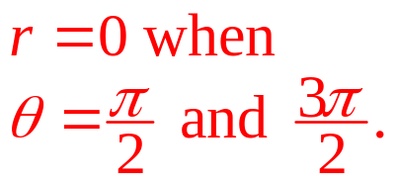
Example: Zeros and Maximum r-values
Example:
Find the zeros and the maximum value of r for the graph of r = 2cos θ.
The maximum value of r is 2. It occurs when θ = 0 and 2π.
0
1
2
3
These are the zeros of r.

Slide 12
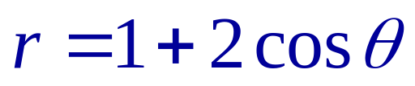
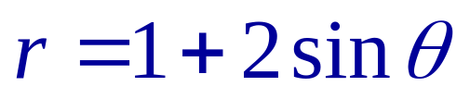
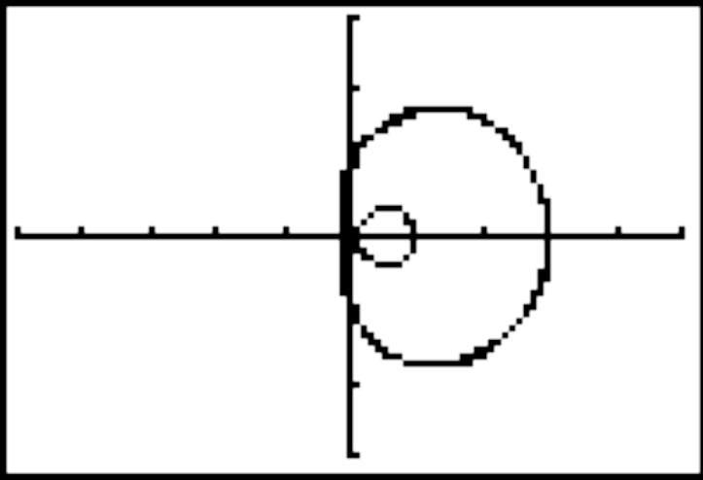
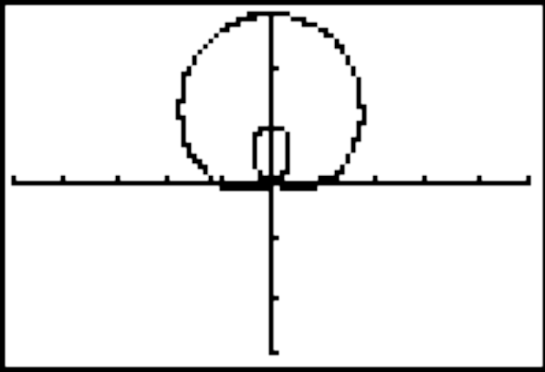
Special Polar Graphs: Limaçon
Each polar graph below is called a Limaçon.
3
3
–5
5
–5
5
–3
–3

Slide 13
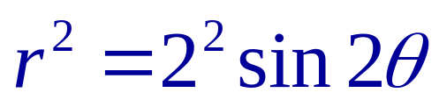
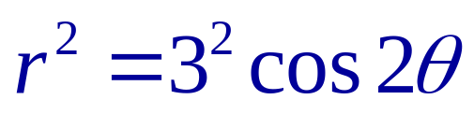
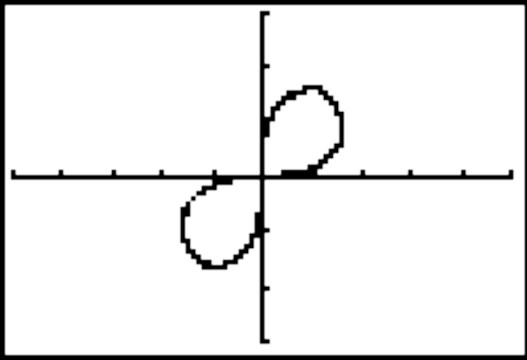
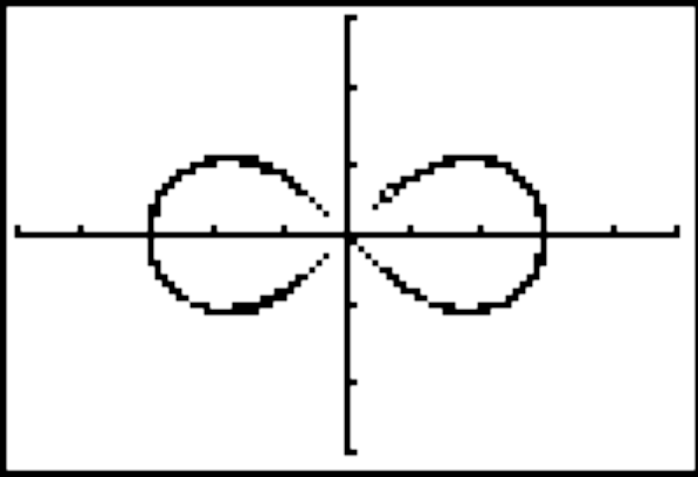
Special Polar Graphs: Lemniscate
Each polar graph below is called a Lemniscate.
3
3
–5
5
–5
5
–3
–3

Slide 14
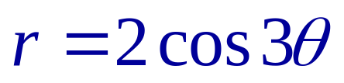
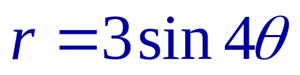
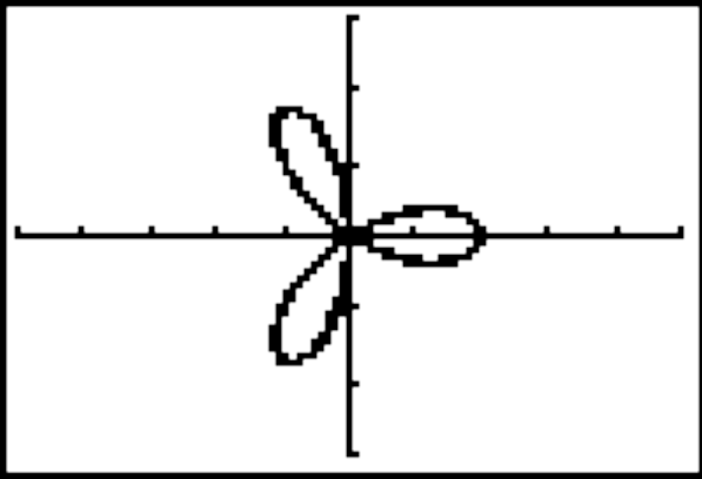
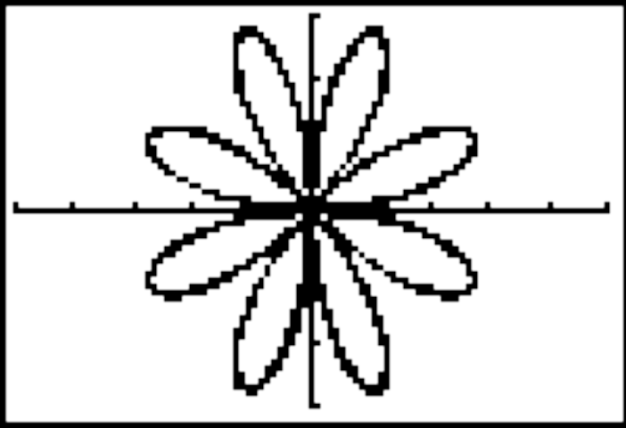
Special Polar Graphs: Rose Curve
Each polar graph below is called a Rose curve.
3
3
a
–5
5
–5
5
a
–3
–3
The graph will have n petals if n is odd, and 2n petals if n is even.

