Slide 1
Concavity and the
Second Derivative Test
Section 3.4

Slide 2
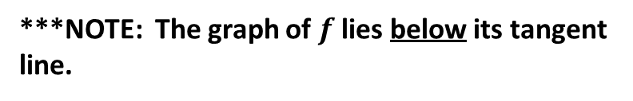
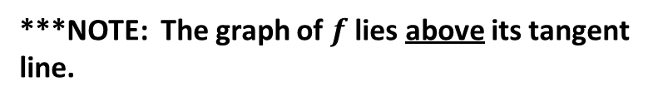
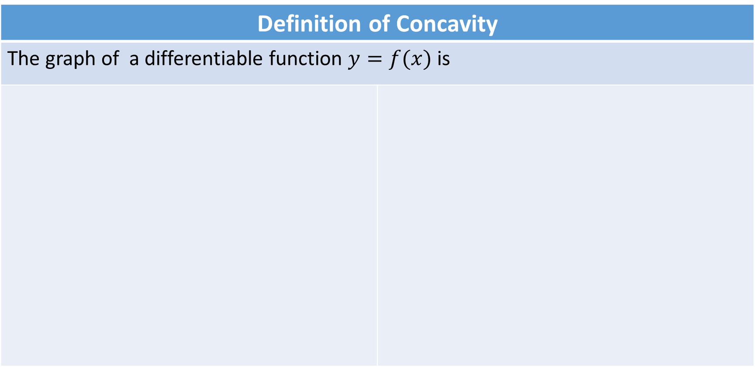
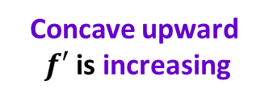
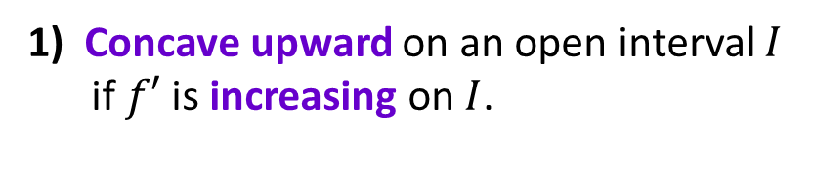
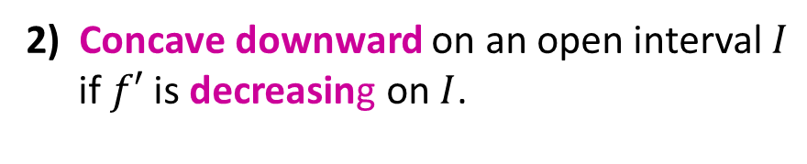
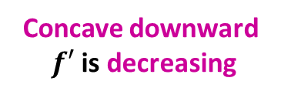
Definition of Concavity
The graph of a differentiable function $y=f(x)$ is
1) Concave upward on an open interval $I$ if $f′$ is increasing on $I$.
2) Concave downward on an open interval $I$ if $f′$ is decreasing on $I$.
Concave upward
$f′$ is increasing
Concave downward
$f′$ is decreasing
***NOTE: The graph of $f$ lies above its tangent line.
***NOTE: The graph of $f$ lies below its tangent line.

Slide 3










LET’S EXAMINE THESE GRAPHS AND STUDY THEIR RELATIONSHIPS
Concave
Downward
Concave
Upward
$$f\left(x\right)=\frac{1}{3}x^{3}−x$$
$$f$$
$$f′′$$
$$f^{′}\left(x\right)=x^{2}−1$$
$$f′$$
$$f^{′′}(x)>0$$
$$f′′\left(x\right)<0$$
$f^{′}$is decreasing
$f^{′}$is increasing

Slide 4
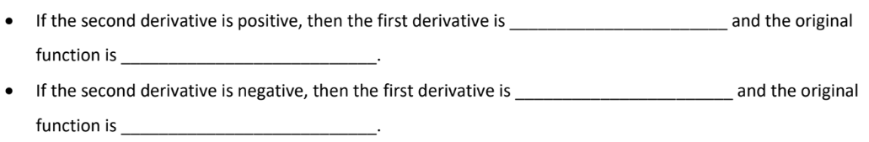
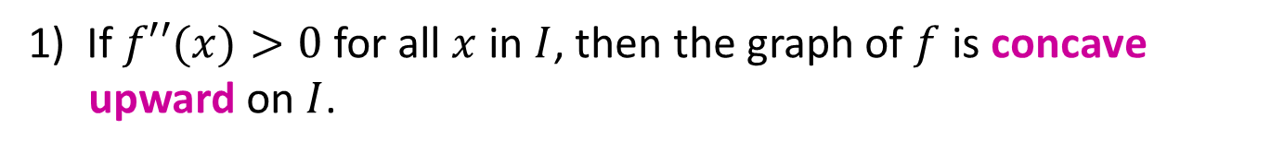
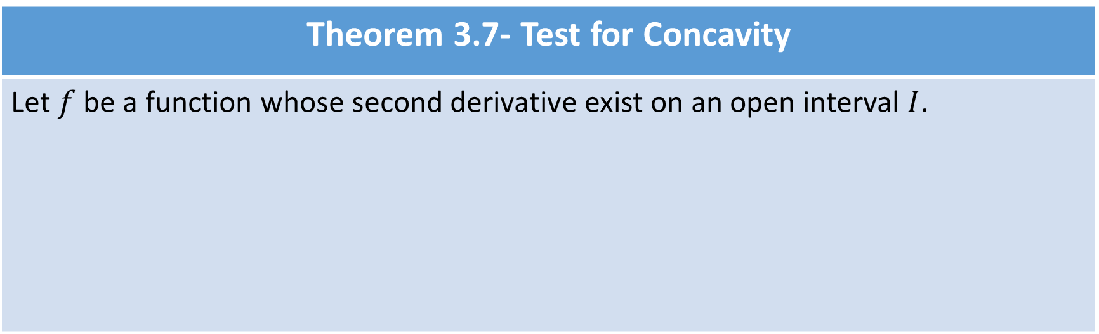
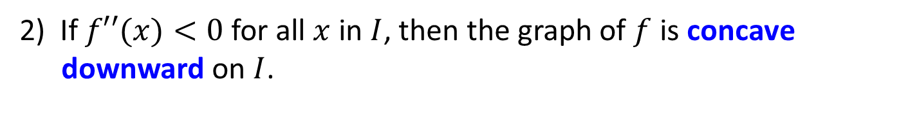
Theorem 3.7- Test for Concavity
Let $f$ be a function whose second derivative exist on an open interval $I$.
1) If $f′′(x)>0$ for all $x$ in $I$, then the graph of $f$ is concave upward on $I$.
2) If $f′′(x)<0$ for all $x$ in $I$, then the graph of $f$ is concave downward on $I$.

Slide 5

Example:
1) Determine open intervals on which the graph of $f\left(x\right)=5−x^{1/3}$ is concave upward or downward.
Concave Upward
Concave Downward

Slide 6
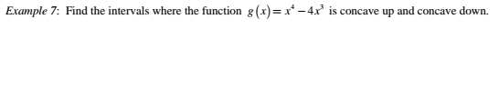

Slide 7
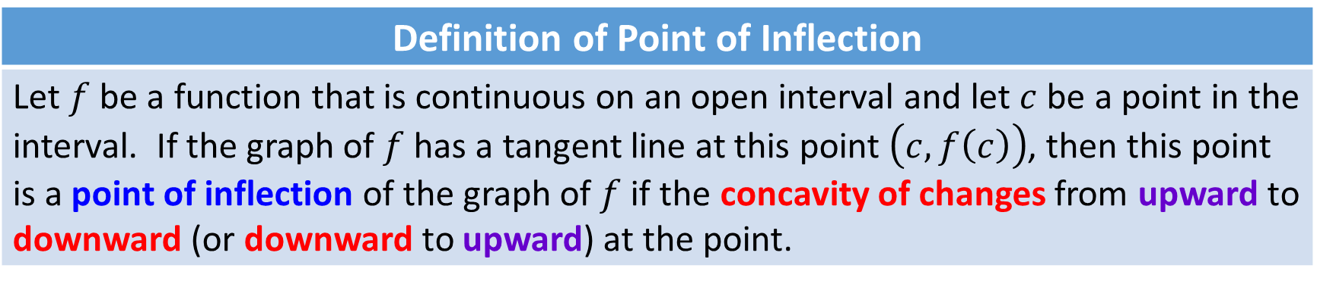
Definition of Point of Inflection
Let $f$ be a function that is continuous on an open interval and let $c$ be a point in the interval. If the graph of $f$ has a tangent line at this point $\left(c, f\left(c\right)\right)$, then this point is a point of inflection of the graph of $f$ if the concavity of changes from upward to downward (or downward to upward) at the point.
Concave Upward
Concave Upward
Concave Downward
Concave Downward
Concave Downward
Concave Upward
The concavity of $f$ changes at a point of inflection. Note that the graph crosses its tangent line at the point of inflection.

Slide 8
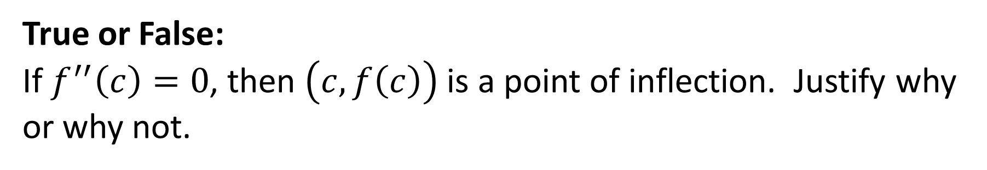
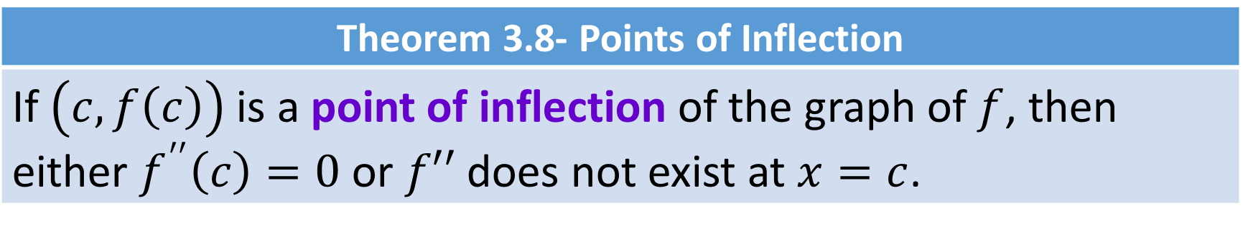
Theorem 3.8- Points of Inflection
If $\left(c,f\left(c\right)\right)$ is a point of inflection of the graph of $f$, then either $f^{′′}\left(c\right)=0$ or $f′′$ does not exist at $x=c$.
True or False:
If $f^{′′}\left(c\right)=0$, then $\left(c,f\left(c\right)\right)$ is a point of inflection. Justify why or why not.

Slide 9
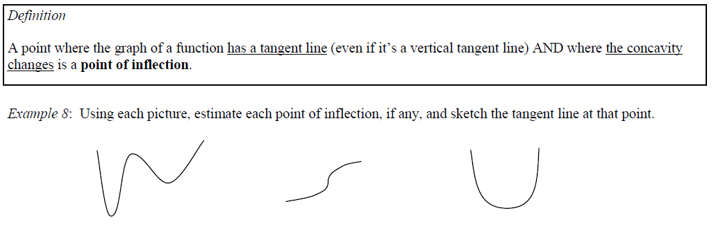
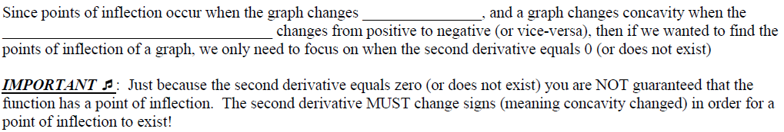

Slide 11


Example:
2) Determine the points of inflection and discuss the concavity of the graph $f\left(x\right)=−x^{4}+2x^{3}$
$$f\left(x\right)=−x^{4}+2x^{3}$$
Concave Upward
Concave Downward
Point of Inflections
Concave Downward

Slide 12
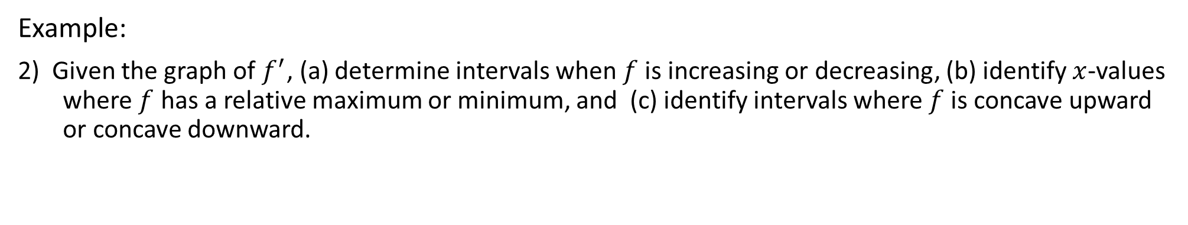


Example:
2) Given the graph of $f^{′}$, (a) determine intervals when $f$ is increasing or decreasing, (b) identify $x$-values where $f$ has a relative maximum or minimum, and (c) identify intervals where $f$ is concave upward or concave downward.
Increasing Decreasing
Rel. Max Rel. Min
Concave Concave
Downward Upward
$$f$$
$$f′$$
AP type question- (d) Identify intervals where $f$ is increasing and concave up.

Slide 13
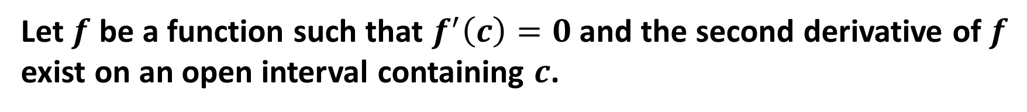
Theorem 3.9- Second Derivative Test
Let $f$ be a function such that $f^{′}\left(c\right)=0$ and the second derivative of $f$ exist on an open interval containing $c$.
1) If $f′′(c)>0$, then $f$ has a relative minimum at $\left(c, f\left(c\right)\right)$.
2) If $f′′(c)<0$, then $f$ has a relative maximum at $\left(c, f\left(c\right)\right)$.
If $f^{′′}\left(c\right)=0$, then the test fails. That is, $f$ may have a relative maximum, a relative minimum, or neither. In such cases, you can use the First Derivative Test.

Slide 14



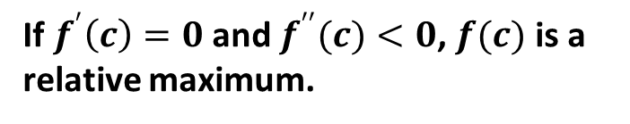
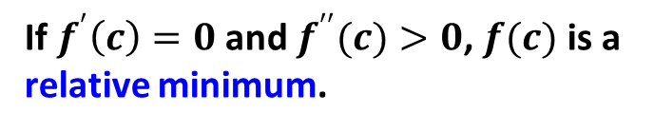

Theorem 3.9- Second Derivative Test
Let $f$ be a function such that $f^{′}\left(c\right)=0$ and the second derivative of $f$ exist on an open interval containing $c$.
$$f^{′′}\left(c\right)<0$$
$$f^{′′}(c)>0$$
Concave Upward
$$f$$
$$f$$
Concave Downward
If $f^{′}\left(c\right)=0$ and $f^{′′}(c)>0$, $f(c)$ is a relative minimum.
If $f^{′}\left(c\right)=0$ and $f^{′′}(c)<0$, $f(c)$ is a relative maximum.
If $f^{′′}\left(c\right)=0$, the test fails. That is, $f$ may have a relative maximum, a relative minimum, or neither. In such cases, you can use the First Derivative Test.

Slide 15
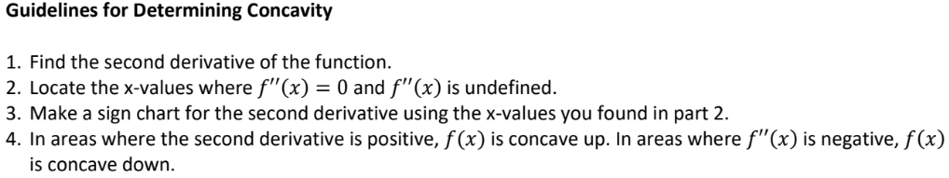

Slide 16
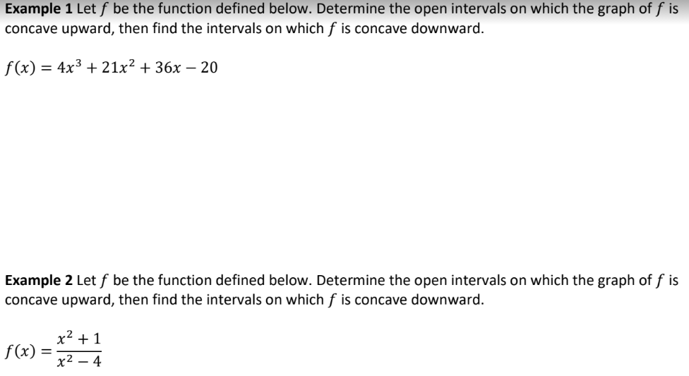

Slide 17

Example:
3) Use the second derivative test to find relative extrema for
$f\left(x\right)=−x^{5}+5x^{3}$.
Relative Maximum
Neither
Relative Minimum

Slide 18

Example:
Given $f\left(x\right)=\sqrt{x}+2$. Use the equation of the tangent line at $x=1$ to approximate $f\left(1.2\right)$. Is this an overestimate or an underestimate? Explain your reasoning.

Slide 19
Work on 4.3 Practice

Slide 20

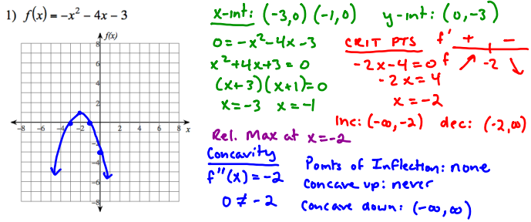

Slide 21
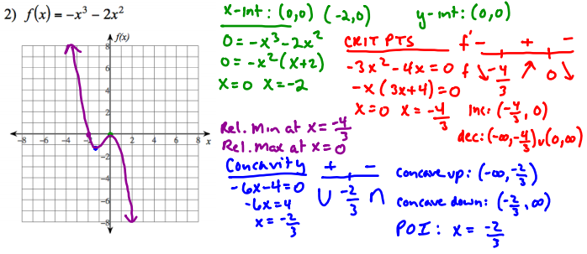

Slide 22
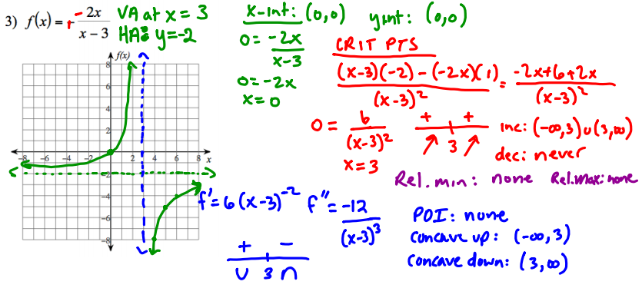

Slide 23
