Slide 1
Volume
Shell Method

Slide 2
Objectives
Find the volume of a solid of revolution using the shell method.
Compare the uses of the disk method and the shell method.

Slide 3
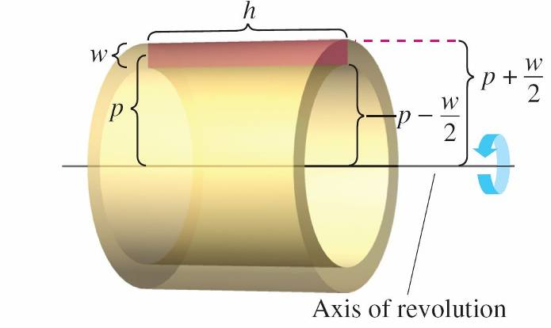
The Shell Method
An alternative method for finding the volume of a solid of revolution is called the shell method because it uses cylindrical shells.
A comparison of the advantages of the disk and shell methods is given later in this section.
Consider a representative rectangle as shown in
Figure, where w is the width
of the rectangle, h is the height of
the rectangle, and p is the distance
between the axis of revolution
and the center of the rectangle.
Figure 7.27

Slide 5
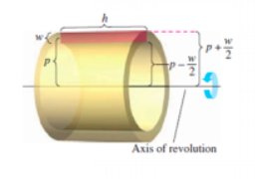
The Shell Method
So, the volume of the shell is
You can use this formula to find the volume of a solid of revolution.

Slide 8
Comparison of Disk and Shell Methods
The disk and shell methods can be distinguished as follows.
For the disk method, the representative rectangle is always perpendicular to the axis of revolution, whereas for the shell method, the representative rectangle is always parallel to the axis of revolution, as shown below.
Figure 7.32

Slide 10
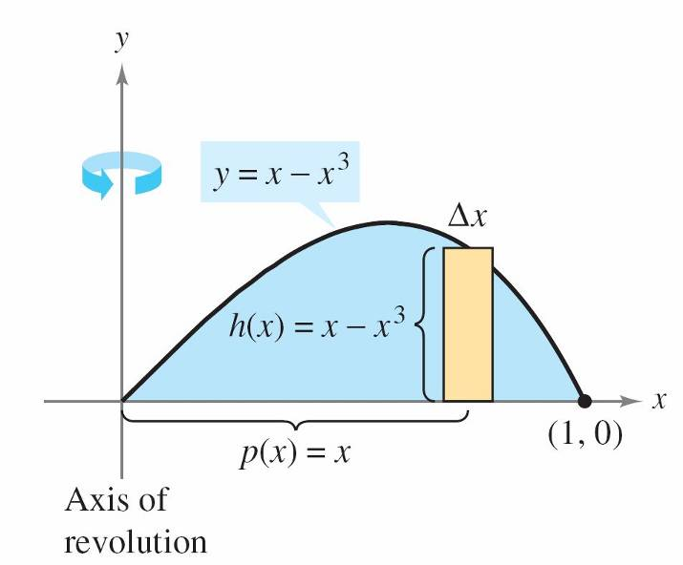
Example – Using the Shell Method to Find Volume
Find the volume of the solid of revolution formed by revolving the region bounded by y = x – x³ and the x-axis (0 ≤ x ≤ 1) about the y-axis.
Solution:
Because the axis of revolution is
vertical, use a vertical representative
rectangle, as shown in Figure 7.30.
The width ∆x indicates that x is the
variable of integration.
Figure 7.30

Slide 11
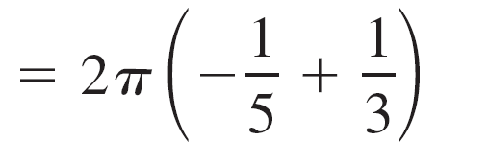
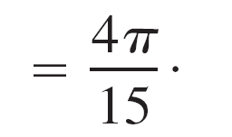
Example – Solution
cont’d
The distance from the center of the rectangle to the axis of revolution is p(x) = x, and the height of the rectangle is
h(x) = x – x³.
Because x ranges from 0 to 1, the volume of the solid is

